Slide 1
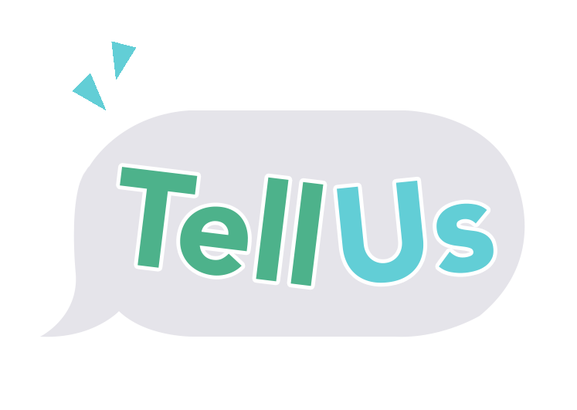



A New Approach to Social-Emotional Learning
Paulina Reyes Jailene Miranda-Enriquez Sanura N’Jaka Na He Jeon
Notes:
Sanura
a. Title your pitch as the opportunity rather than just the title of the project

Slide 2
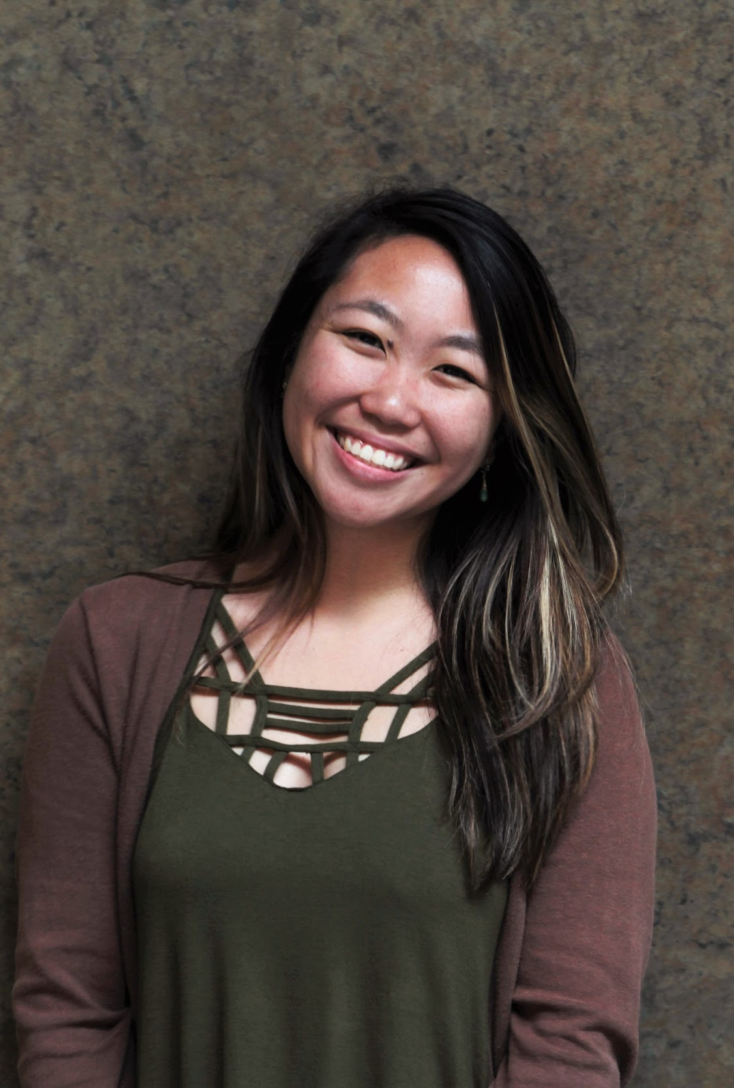
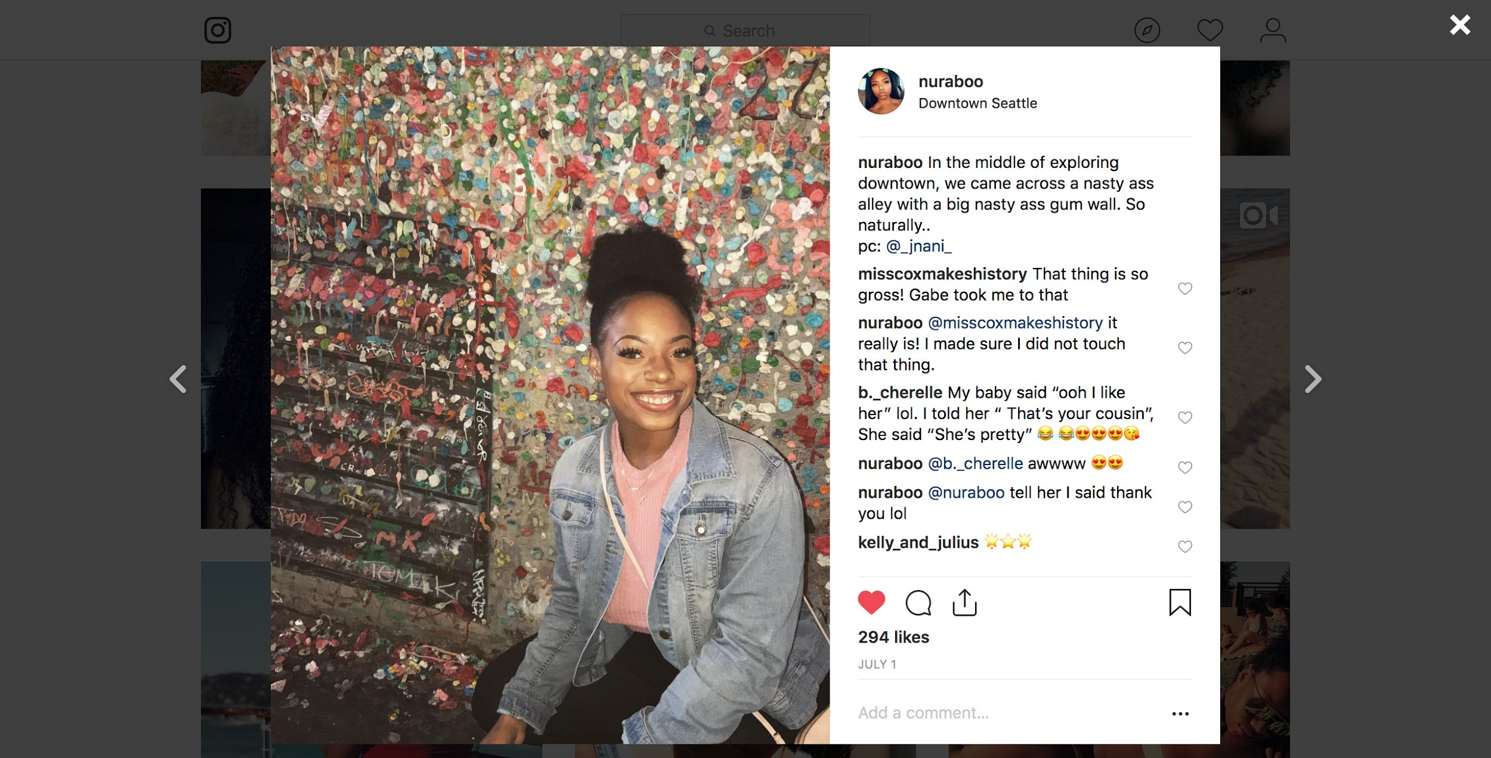

The Team
Paulina
Jailene
Sanura
Na He
Junior, CS
Junior, CS
Junior, CS
Co-term, CS
Notes:
Sanura

Slide 3
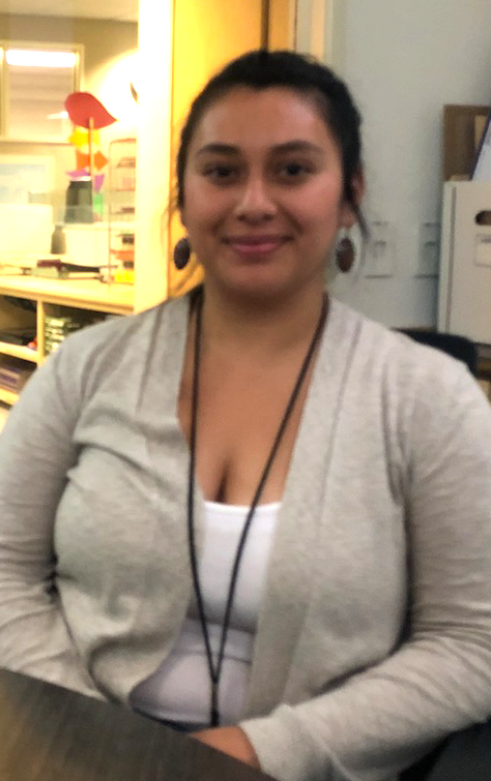
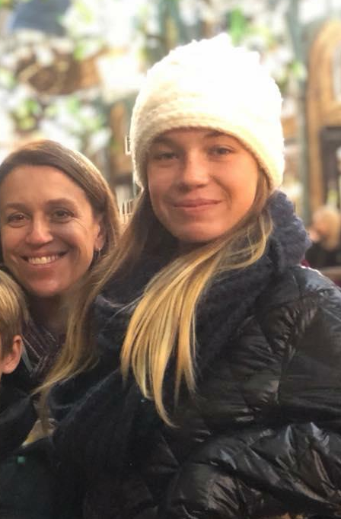
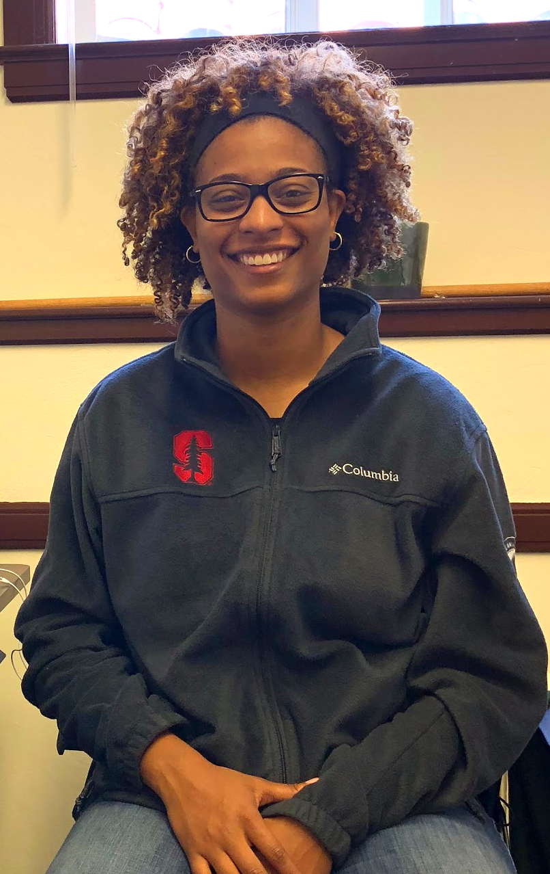
Outline
Finding a Problem
Notes:
Sanura
(briefly tell us what you are going to tell us in the rest of the talk – tell a story!!)

Slide 4
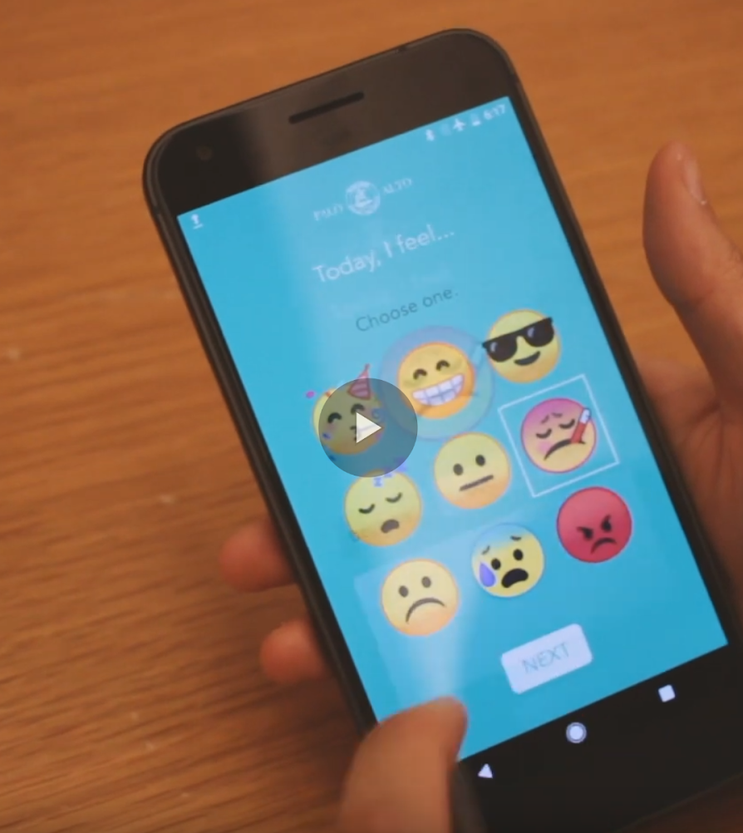
Outline
Our Solution
Prototype Video
Finding a Problem
Notes:
Sanura
(briefly tell us what you are going to tell us in the rest of the talk – tell a story!!)

Slide 5
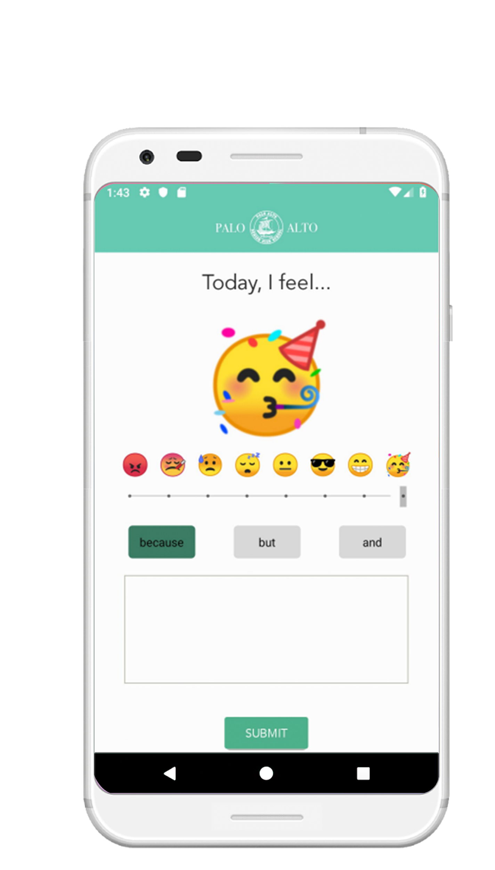
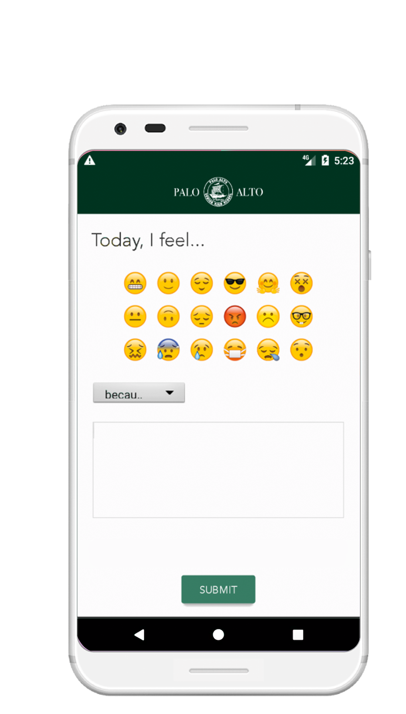
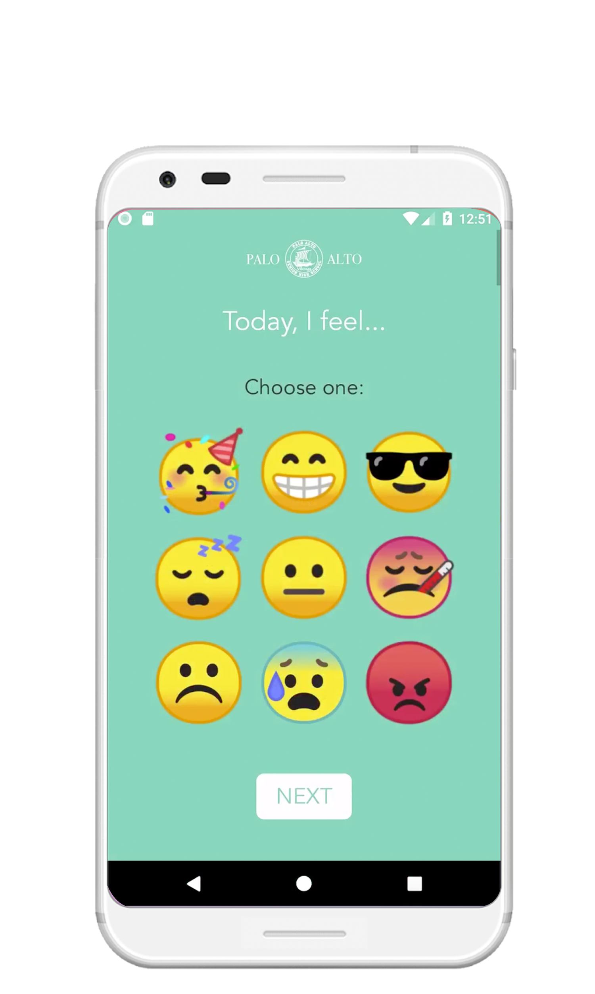
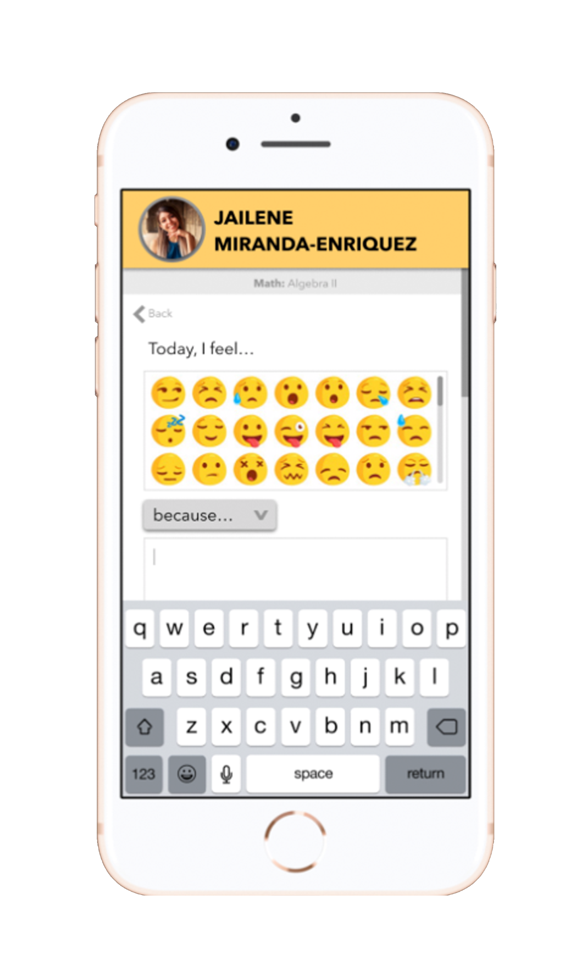
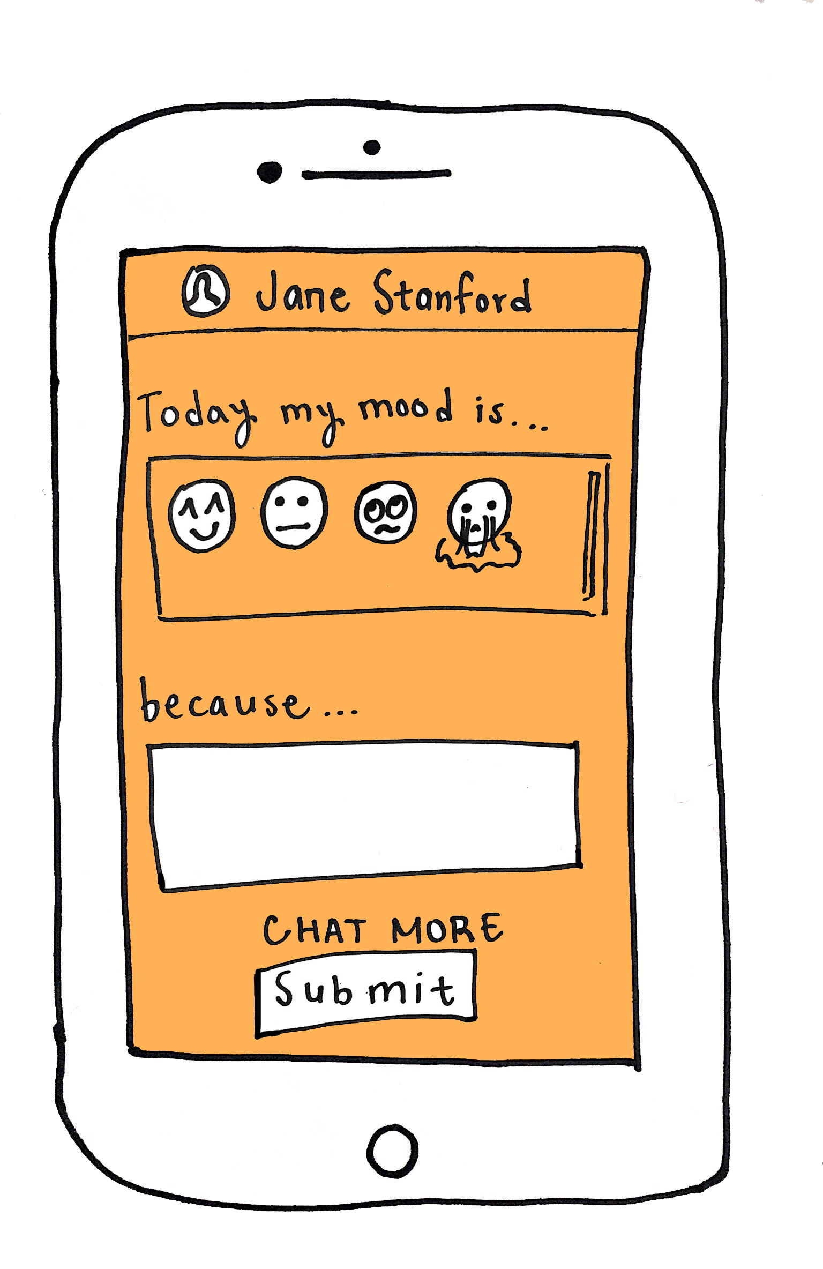
Outline
Our Solution
Prototype Video
Design Evolution
Finding a Problem
Notes:
Sanura
(briefly tell us what you are going to tell us in the rest of the talk – tell a story!!)

Slide 6
Outline
Our Solution
Prototype Video
Design Evolution
Finding a Problem
User Interface
Implementation + Future Plans
Notes:
Sanura
(briefly tell us what you are going to tell us in the rest of the talk – tell a story!!)

Slide 7

Outline
Our Solution
Prototype Video
Design Evolution
Finding a Problem
Conclusion
User Interface
Implementation + Future Plans
Notes:
Sanura
(briefly tell us what you are going to tell us in the rest of the talk – tell a story!!)

Slide 8

Problem
Notes:
Jailene

Slide 9
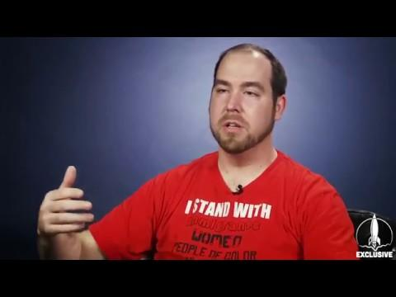
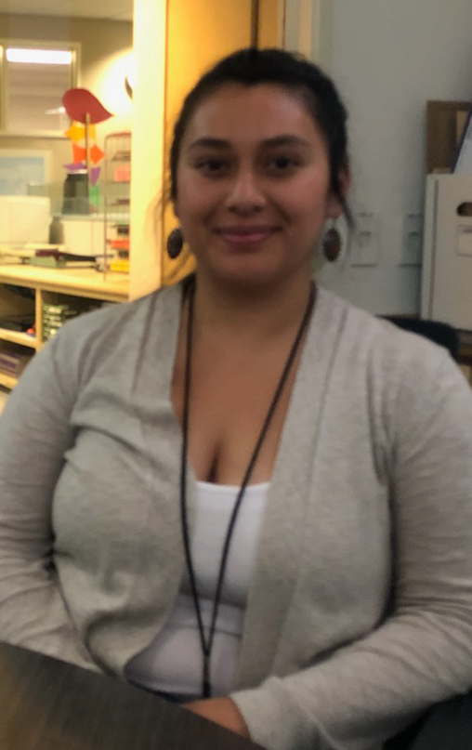
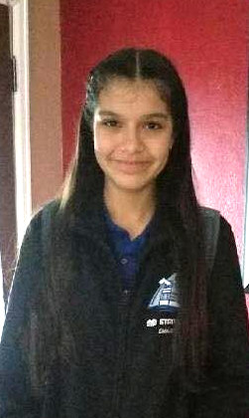
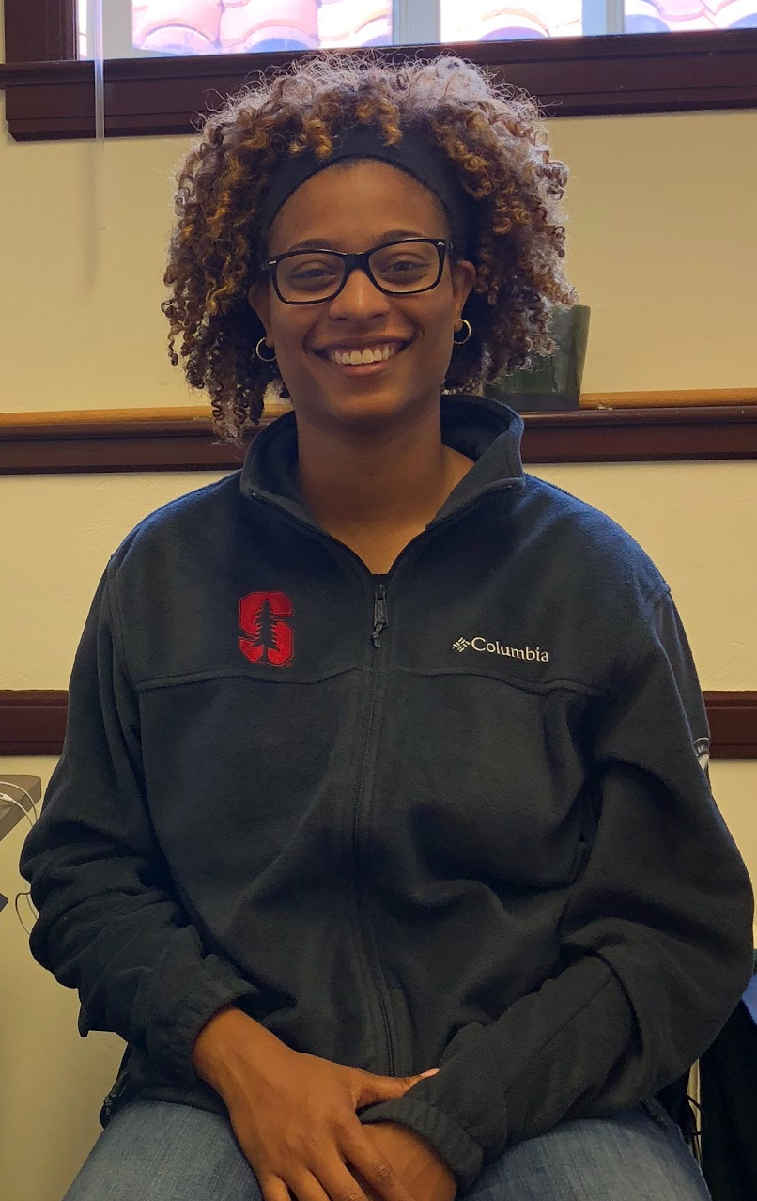
Needfinding
Educators
Students
Notes:
Jailene
For needfinding, we went out and talked to as many educators and students as we possibly could. One thing was emphasized over and over again: The need for connection. In fact, these sentiments are even echoed in statements from teachers who went on strike in the LAUSD, which we’ll show you a clip of now.

Slide 10
How might we build positive student-teacher connections?
“Students who feel supported and valued by their teachers demonstrate increased self-esteem and self-efficacy” (Gallagher, 2017)
Notes:
Jailene
our main problem statement that we decided to tackle is how might we build positive student-teacher connections? When doing research on social-emotional learning, we found this a study by Gallagher, an educational psychologist, and he mentions how

Slide 11
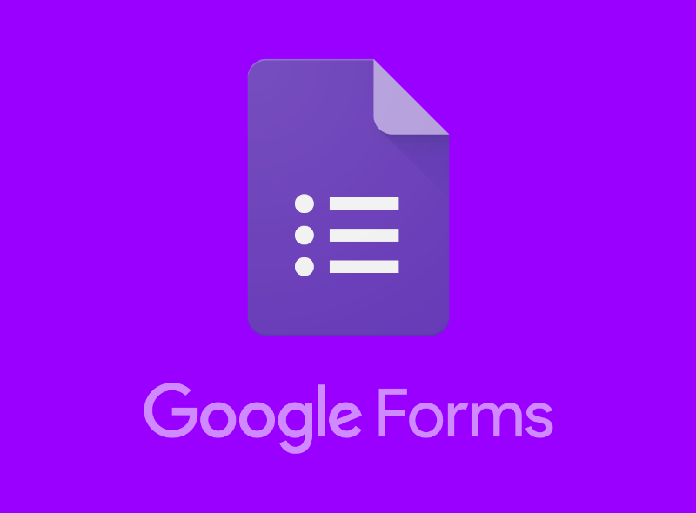
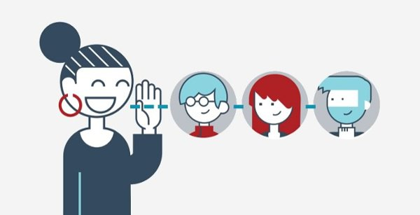

Existing Solutions
Direct, verbal communication
Notes:
Jailene
The most common form of “checking in” is through verbal communication- this takes time and energy, and requires 1-on-1 attention.
There are no other common “check-in” tools other than Google Forms and Poll Everywhere. But still with this, teachers would have to take out the time to create the forms themselves. TellUs does all the hard work for them! All they have to do is submit and go.

Slide 12
Solution
Notes:
Sanura

Slide 13
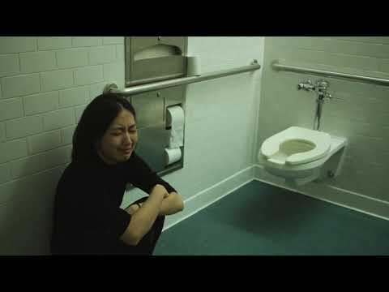
Prototype Video
Notes:
Sanura
Now we'll show you our solution to this problem.

Slide 14
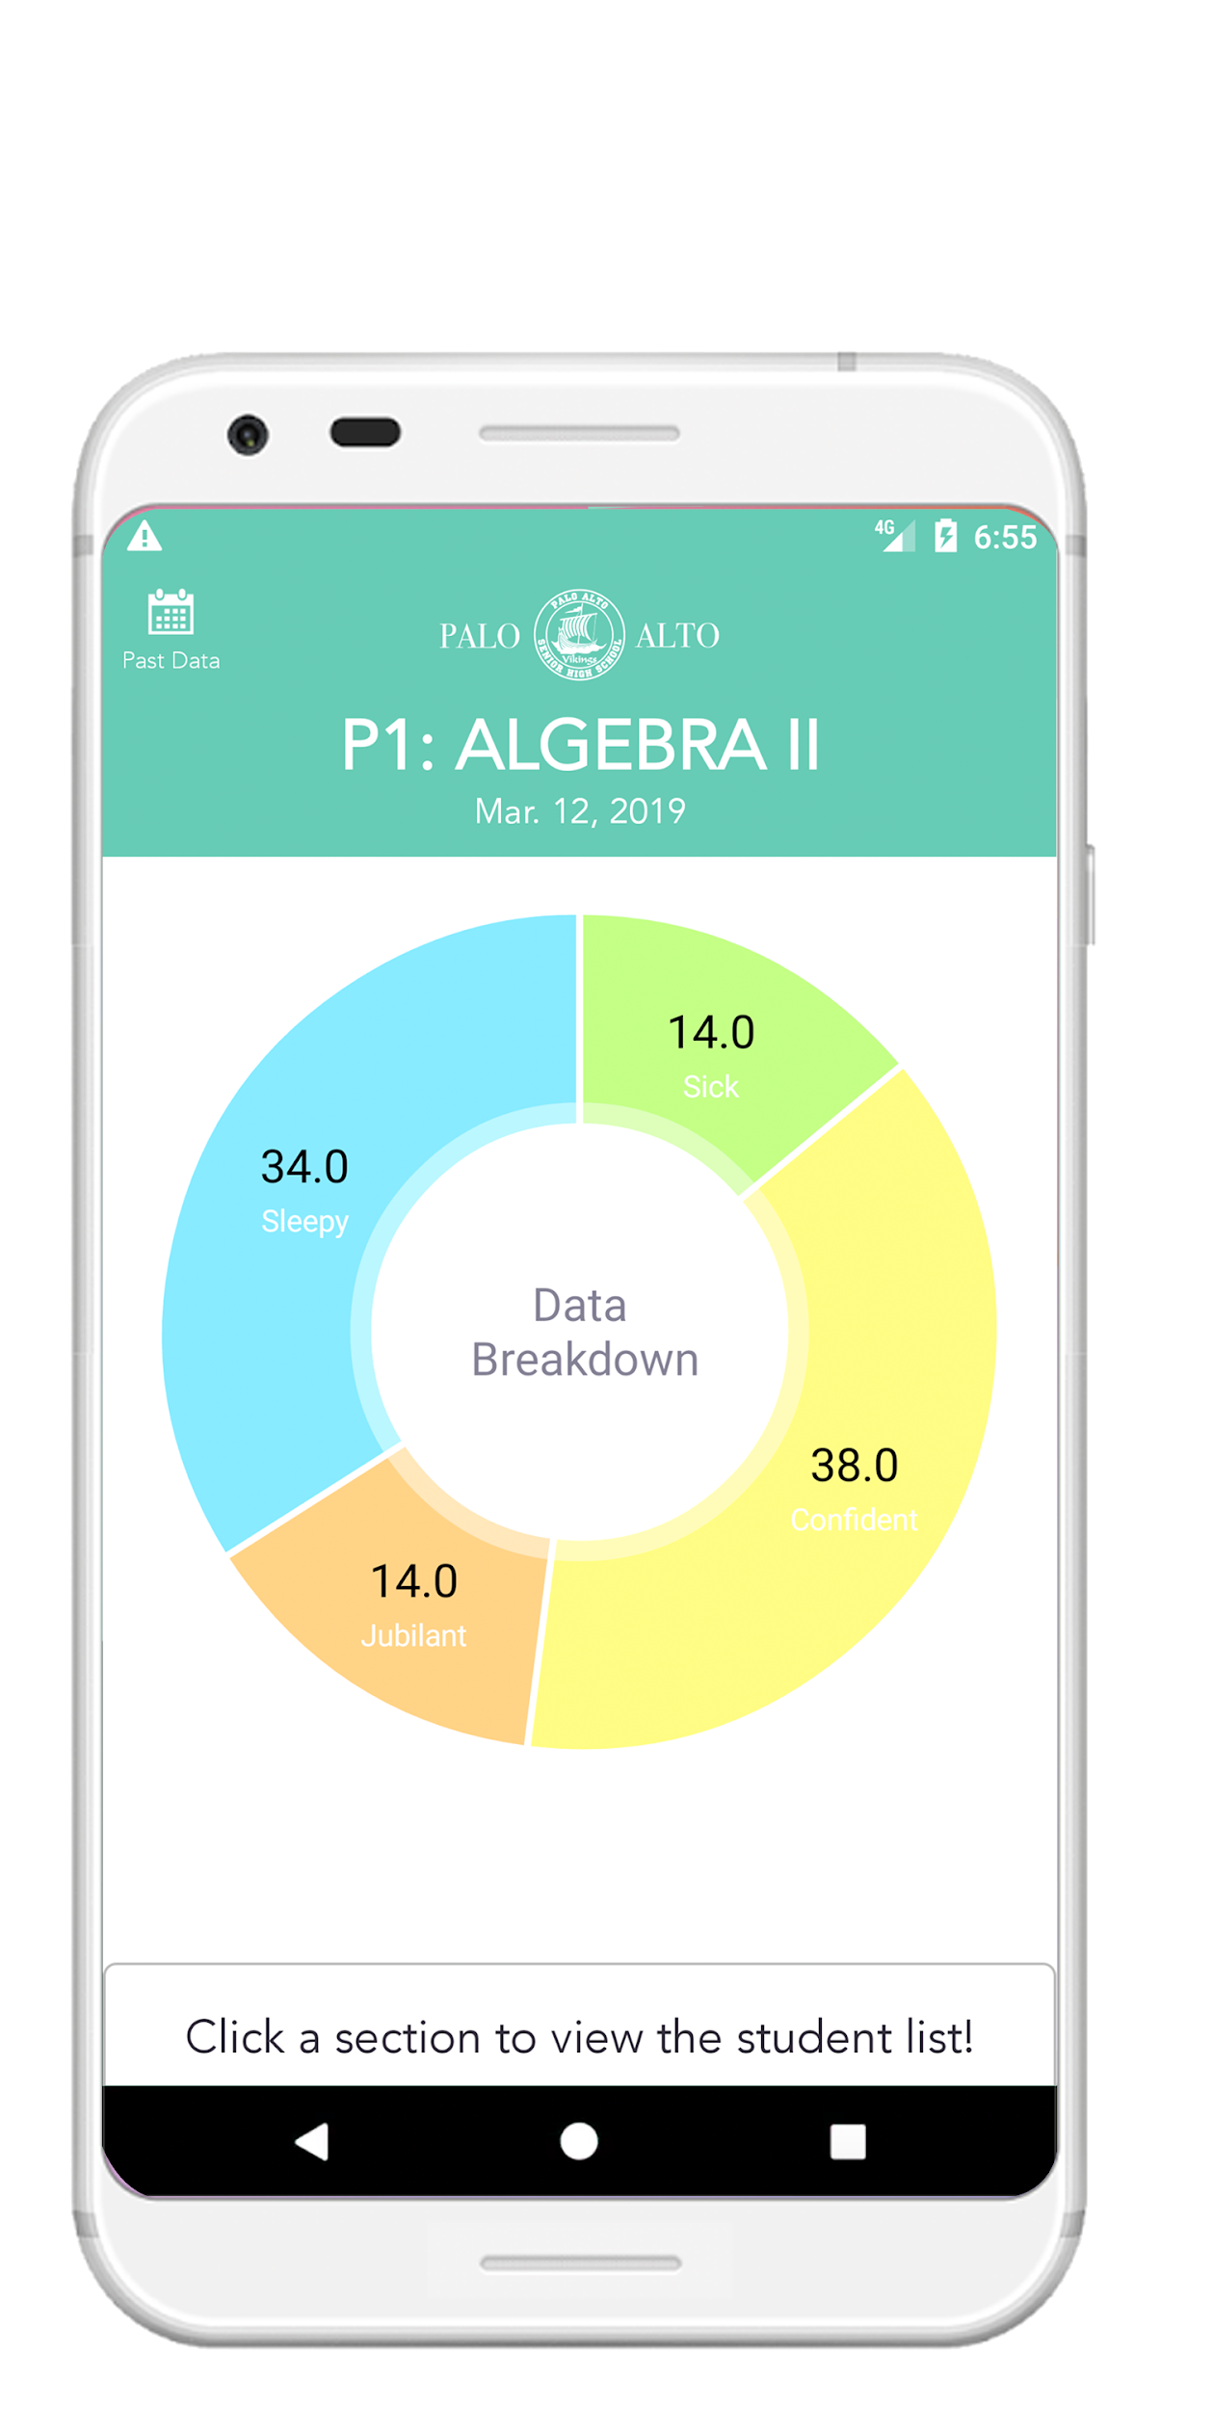
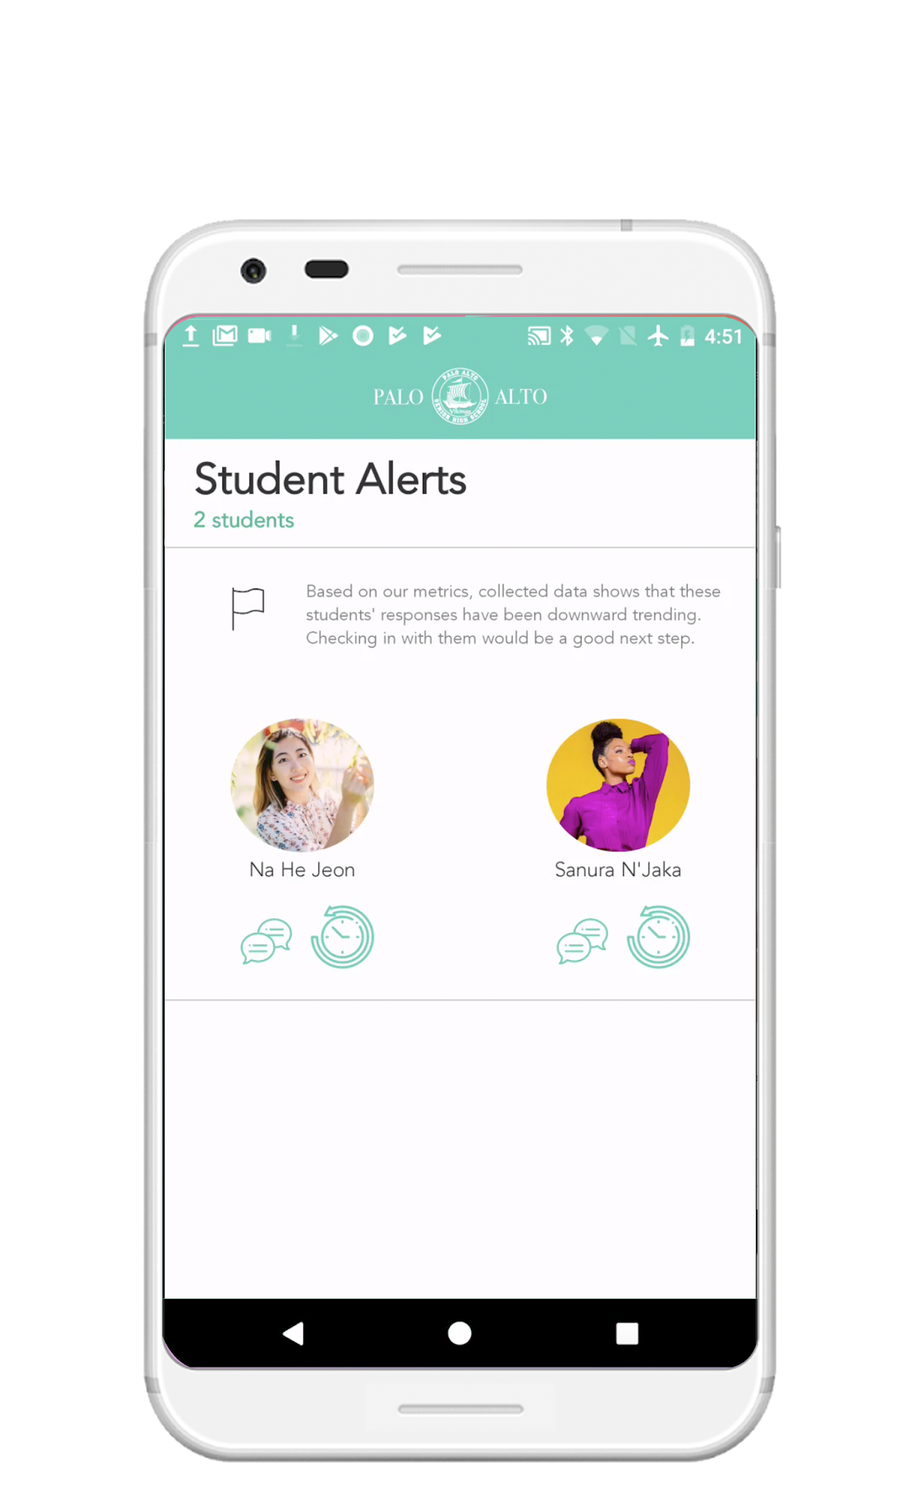
Connect and engage with your students
Check-in Feelings
View submissions
Student Alerts
Notes:
Sanura
As you saw on the video, TellUs allows teachers to connect and engage with their students by both parties checking in their feelings, teachers viewing the class submissions, and receiving alerts about student who might need more attention

Slide 15
Design Evolution

Slide 16
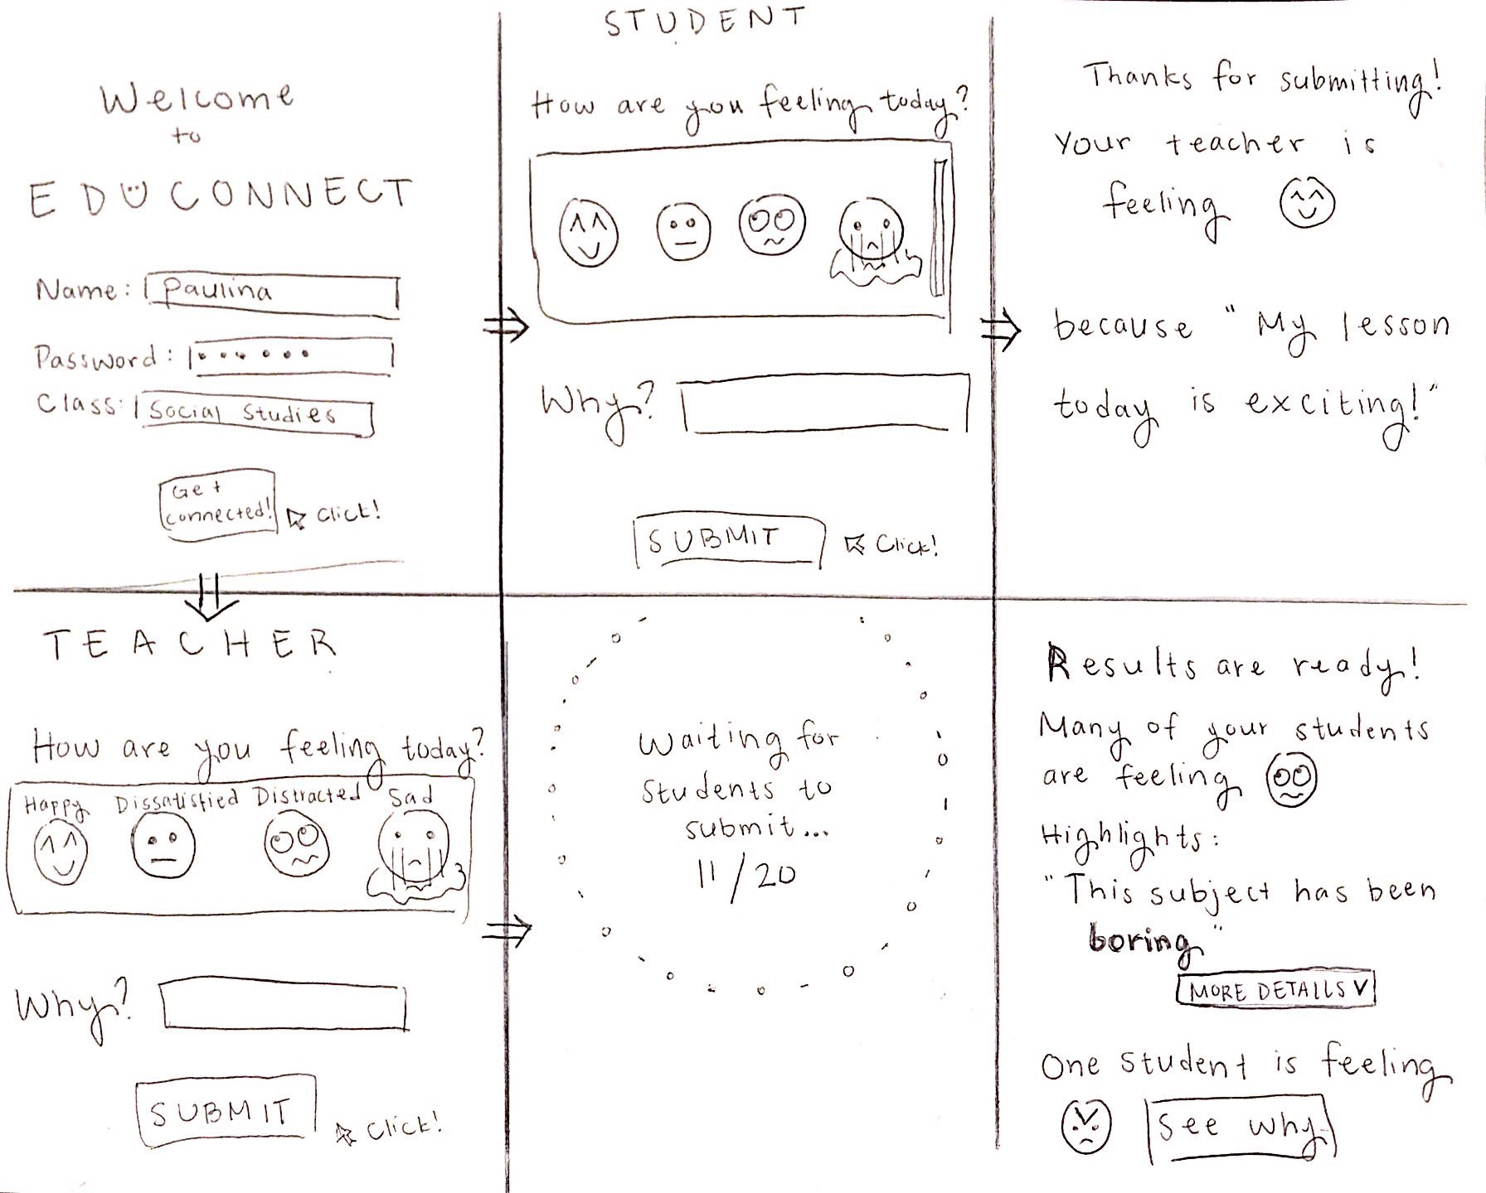
Storyboarding
Notes:
Jailene
When first coming up with a solution to our problem, we wanted to make the check-in activity fun for students, so we decided to use emojis for them to use to submit how they are feeling. We also wanted to provide the teacher with a data synthesis of how their students are feeling in a separate page interface.

Slide 17
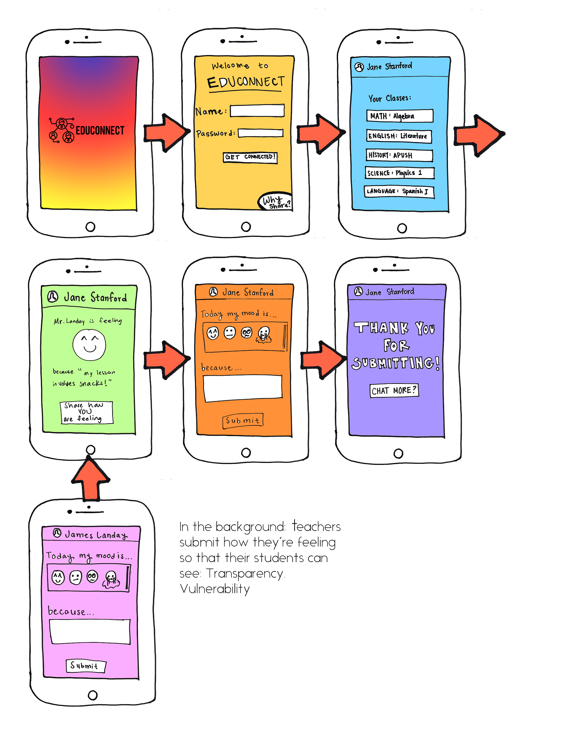
Low-Fi Prototype: Student Interface
Notes:
Jailene
A change from out storyboard is that we decided to include the teacher’s response before a student submits their response so that the student feels prompted to be open about their feelings

Slide 18
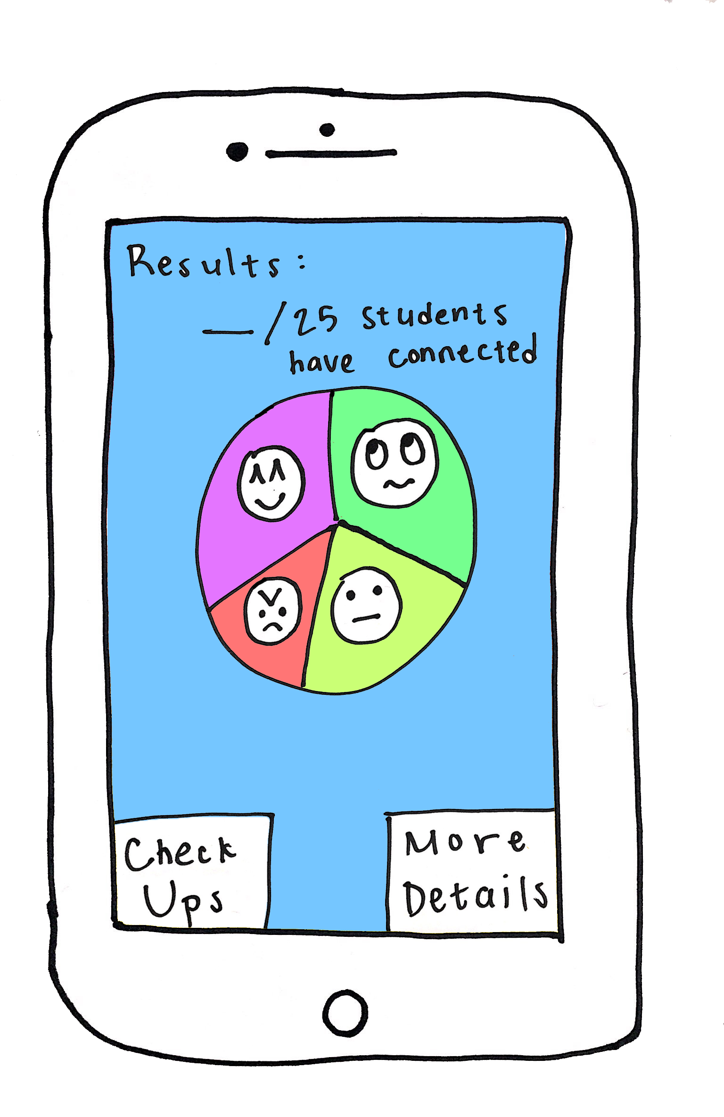
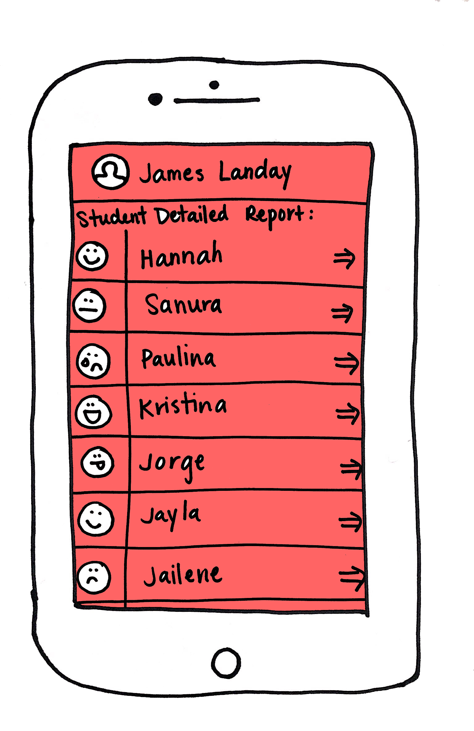
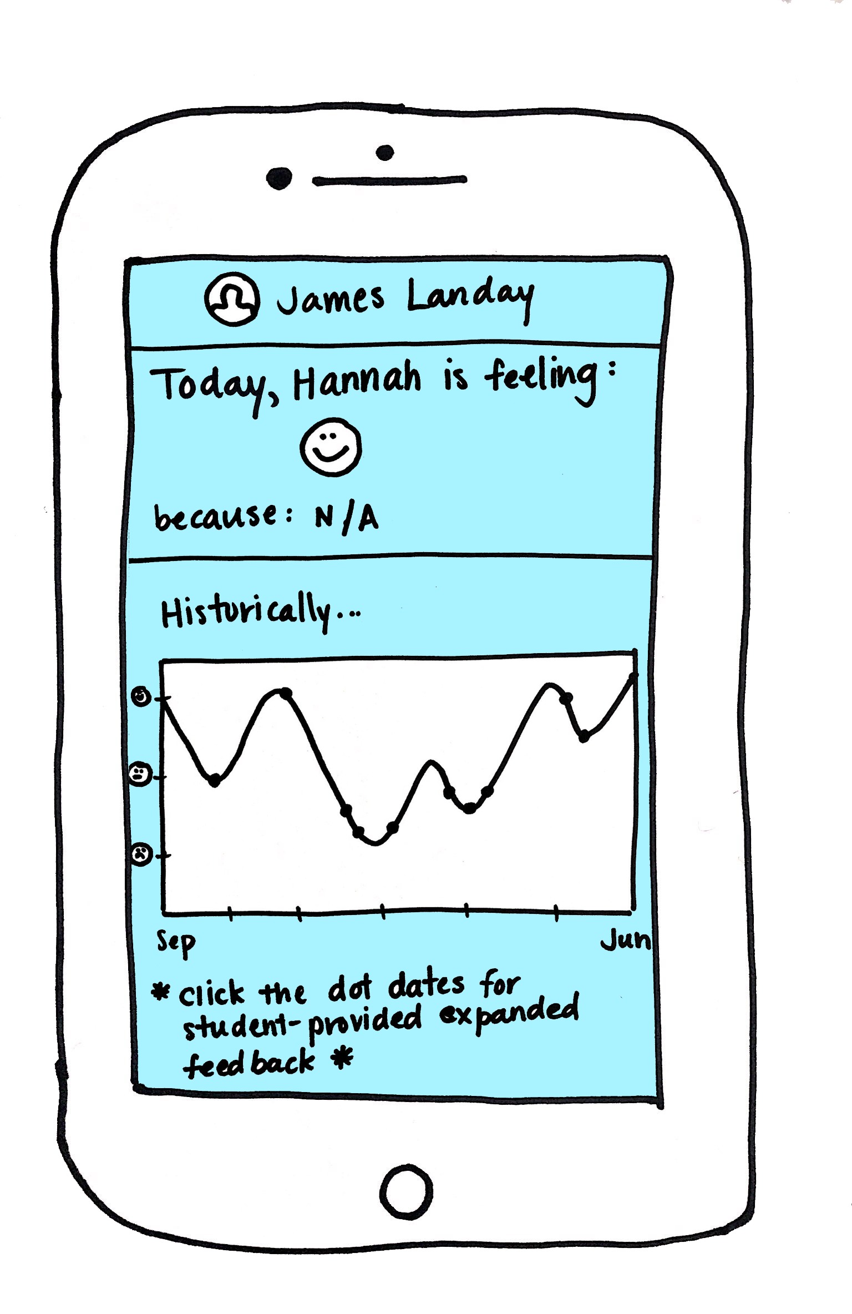
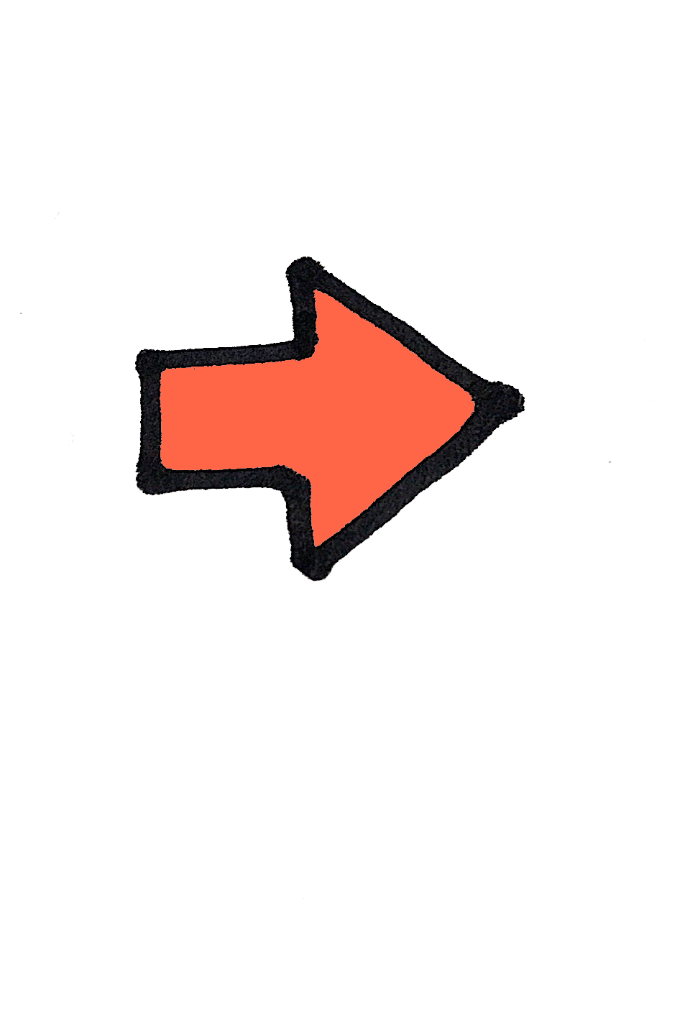
Low-Fi Prototype: Teacher Interface
Notes:
Jailene
Major changes from our storyboard:
-adding a pie graph for the data synthesis
-creating a separate interface to view a detailed report of the class in which each student has a profile where the teacher can view their response history

Slide 19
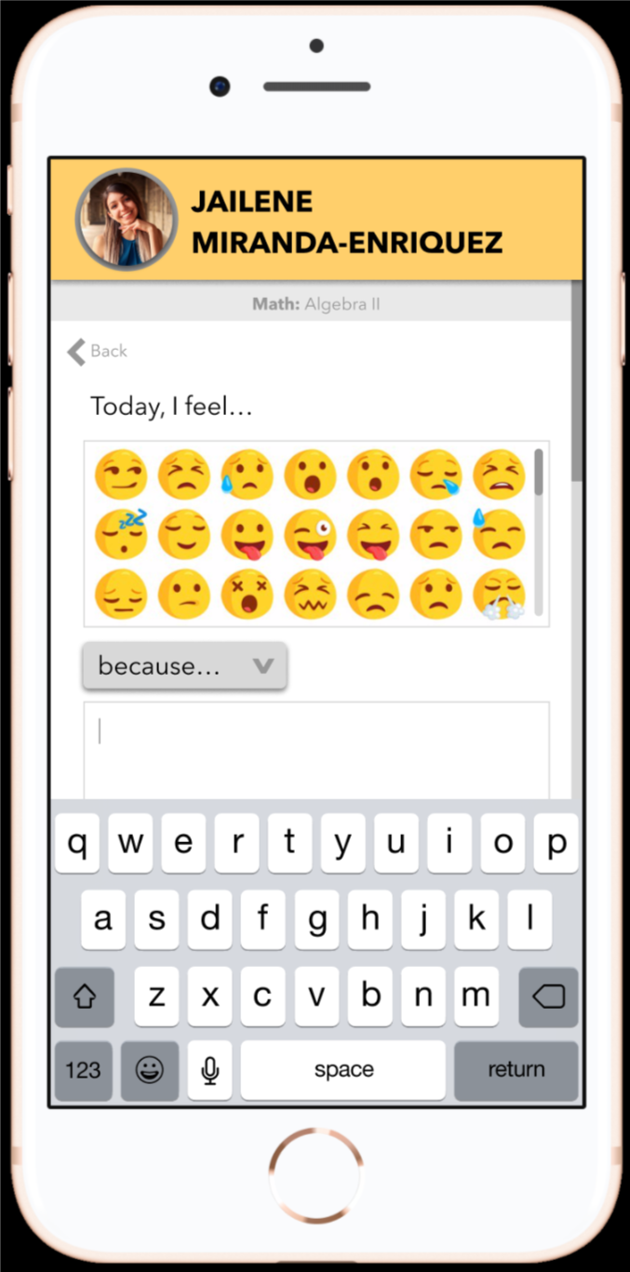
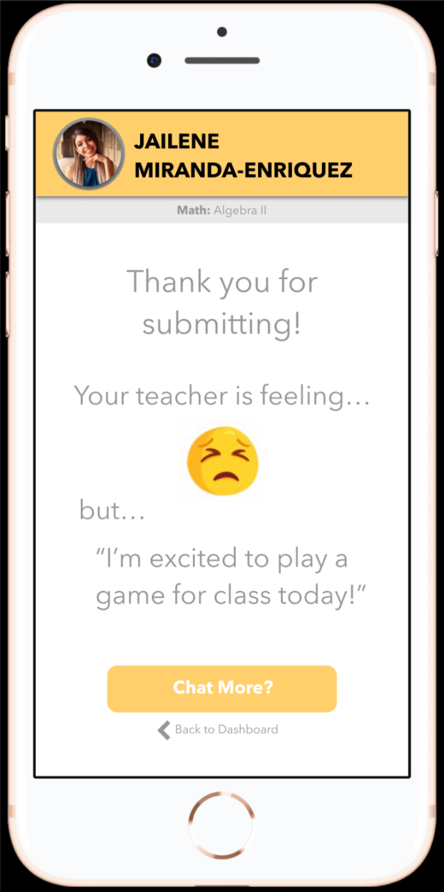
Medium-Fi Prototype: Student Interface
Notes:
Jailene
After testing our low-fi prototype, we received feedback to include the teacher response after the student submits so that it doesn’t influence their own response.
So, we used Figma to make a medium-fi prototype that focuses solely on interface, and not on functionality.
You’ll see here that after deciding to incorporate a messaging system, we added a dashboard to the student interface, which previously only appeared on the teacher-side interface.
For students to message their teachers, they can select “Chat More” here after submit how they are feeling to send a message to their teacher.

Slide 20
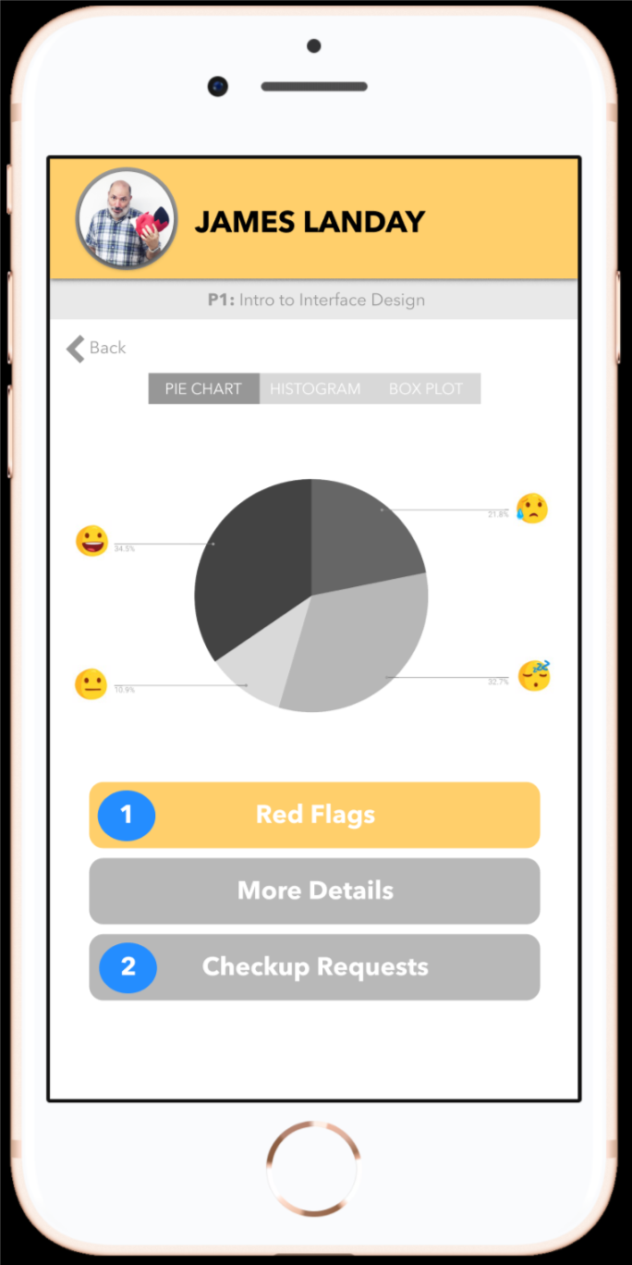
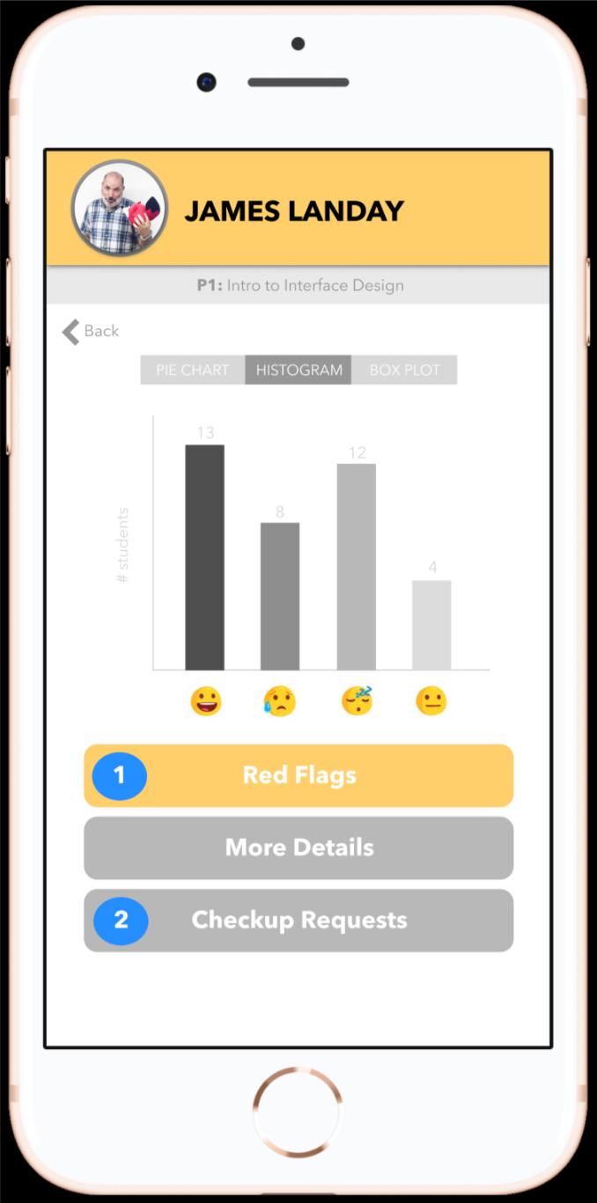
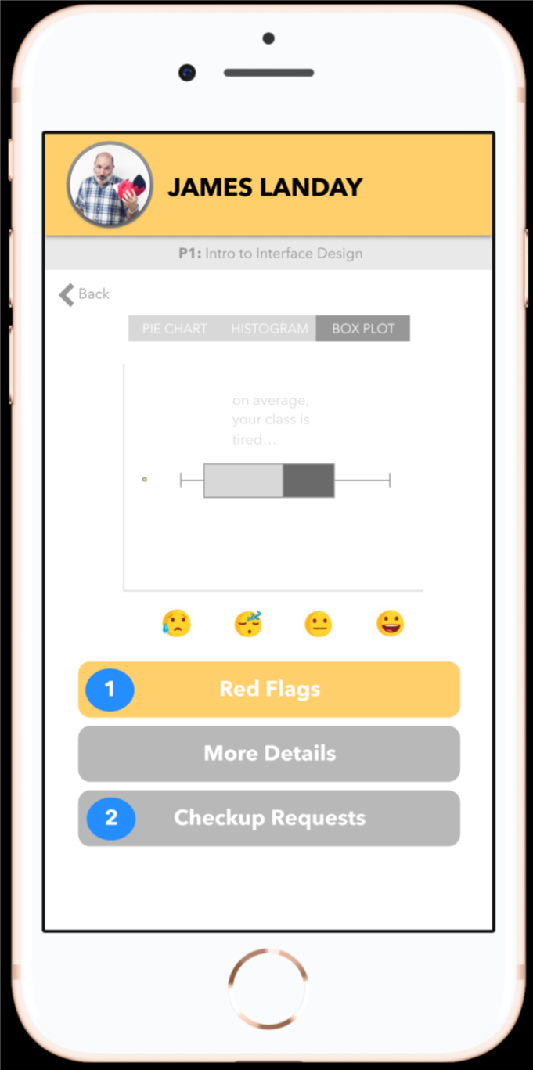
Medium-Fi Prototype: Teacher Interface
Notes:
Jailene
After testing our low-fi prototype, teachers gave us feedback that they wanted more options to view the data so that it’s more customizable, so for our med-fi prototype, we provided the options to view data in a pie chart, histogram, and box plot.

Slide 21
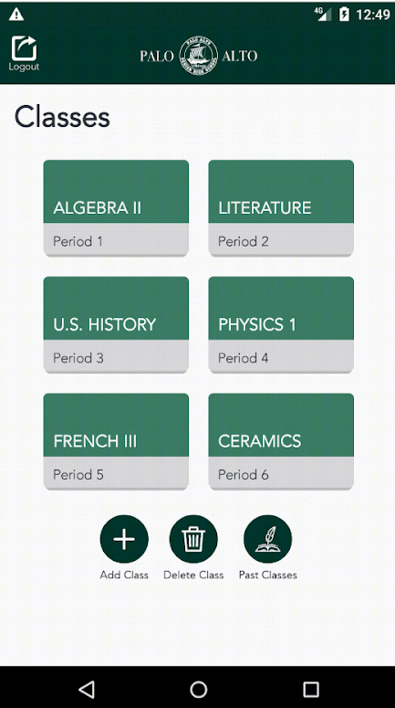
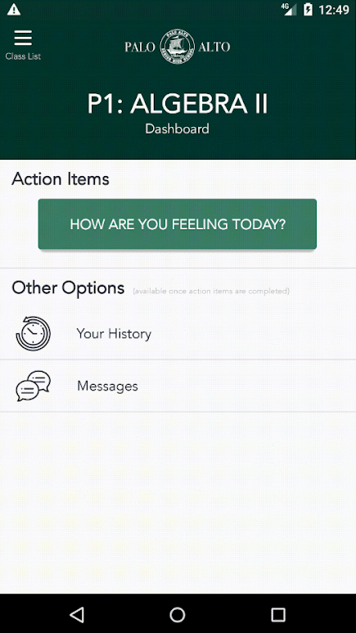
Initial Hi-Fi Prototype
Notes:
Sanura
After peer evaluations on our med-fi prototype, our hi-fi prototype changed drastically:
-color scheme
-layout of classes/dashboard
-added a top bar in certain pages to inform user of what interface they are in

Slide 22
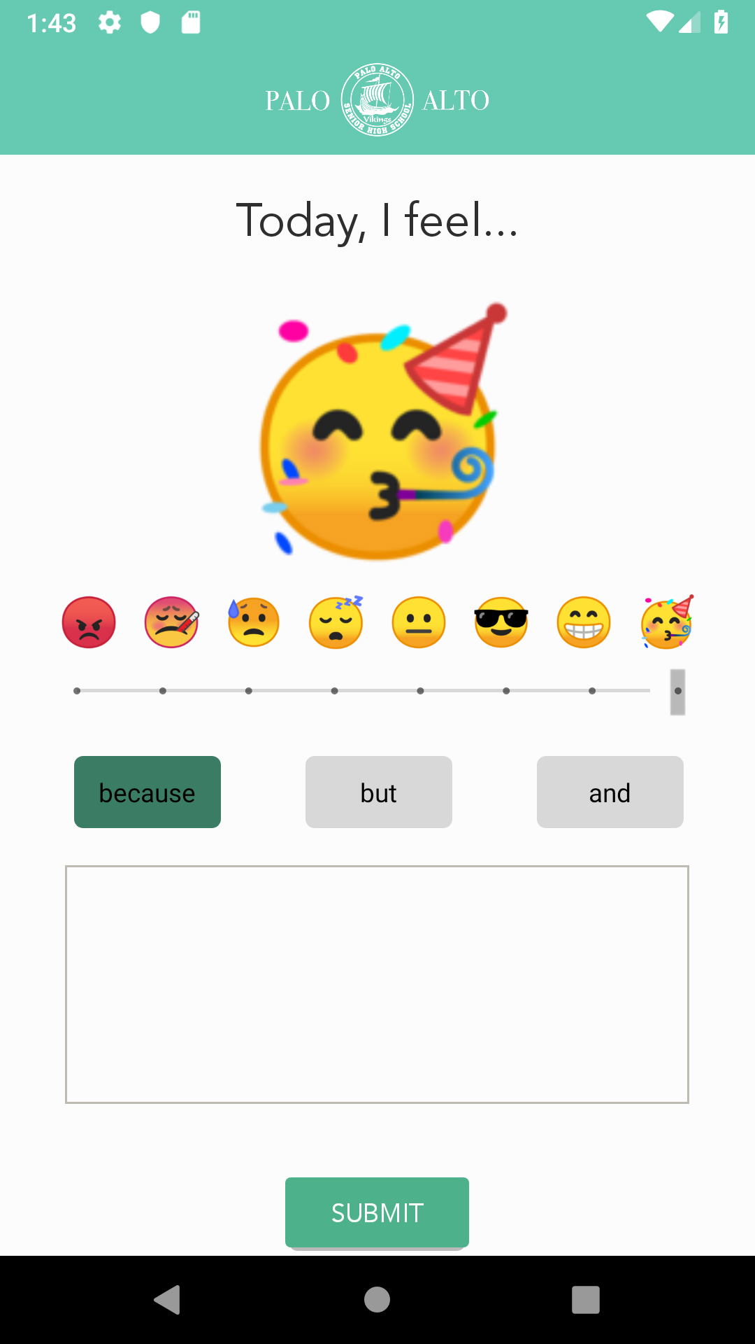
Lab Usability Test
Field Usability Test
Include more representative emotions and less emojis
Slider not that intuitive
Notes:
Sanura
When we tested our initial hi-fi prototype this quarter in a classroom setting, the main feedback we received from students was regarding the emoji list:
-they wanted the emojis to better represent their emotional/physical state such as the sleepy emoji
- they also wanted less emojis bc it was too cluttered
so to better view tthis list, we Decided to create an emoji slider, but when we ran our field usability test, it was not so intuitive

Slide 23
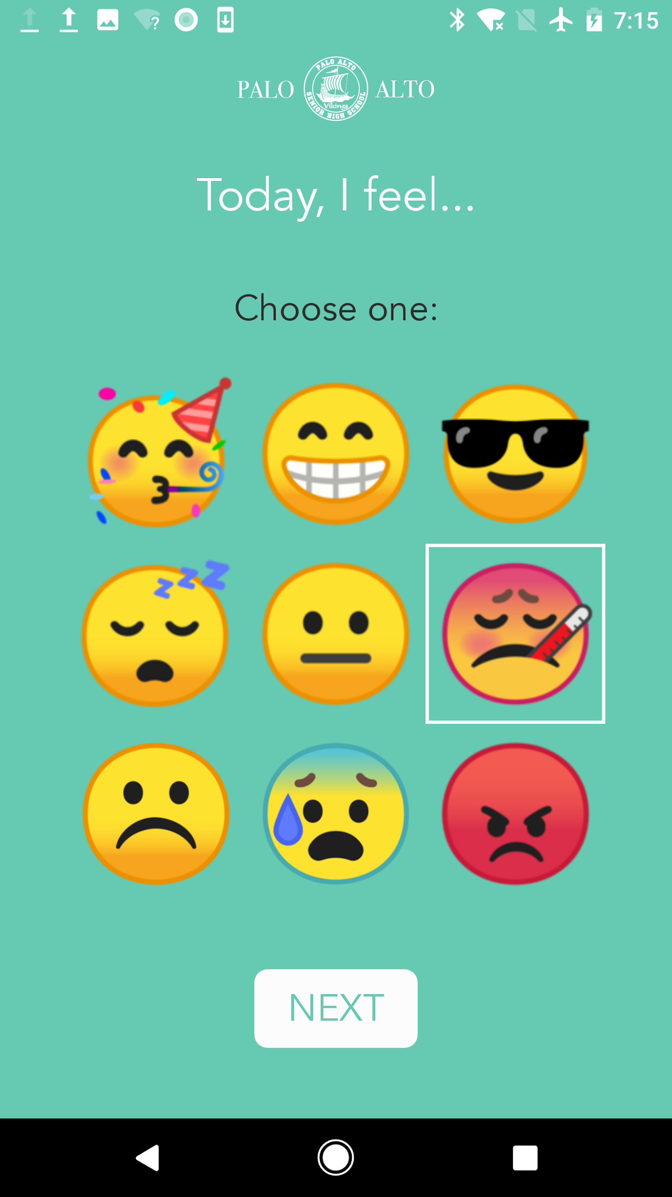
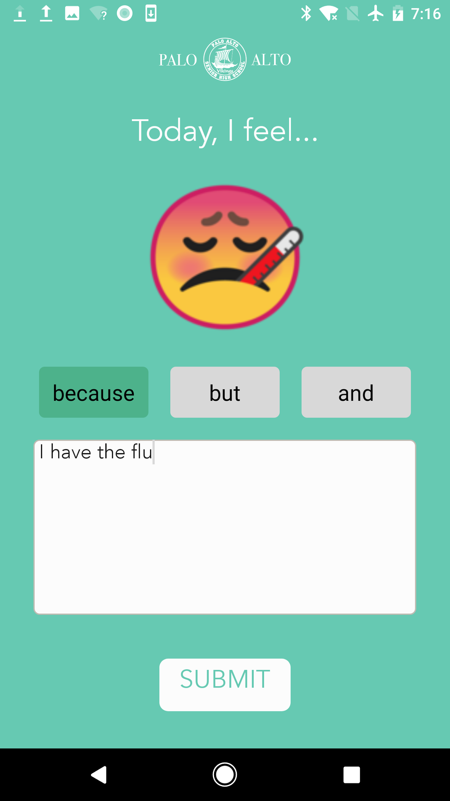
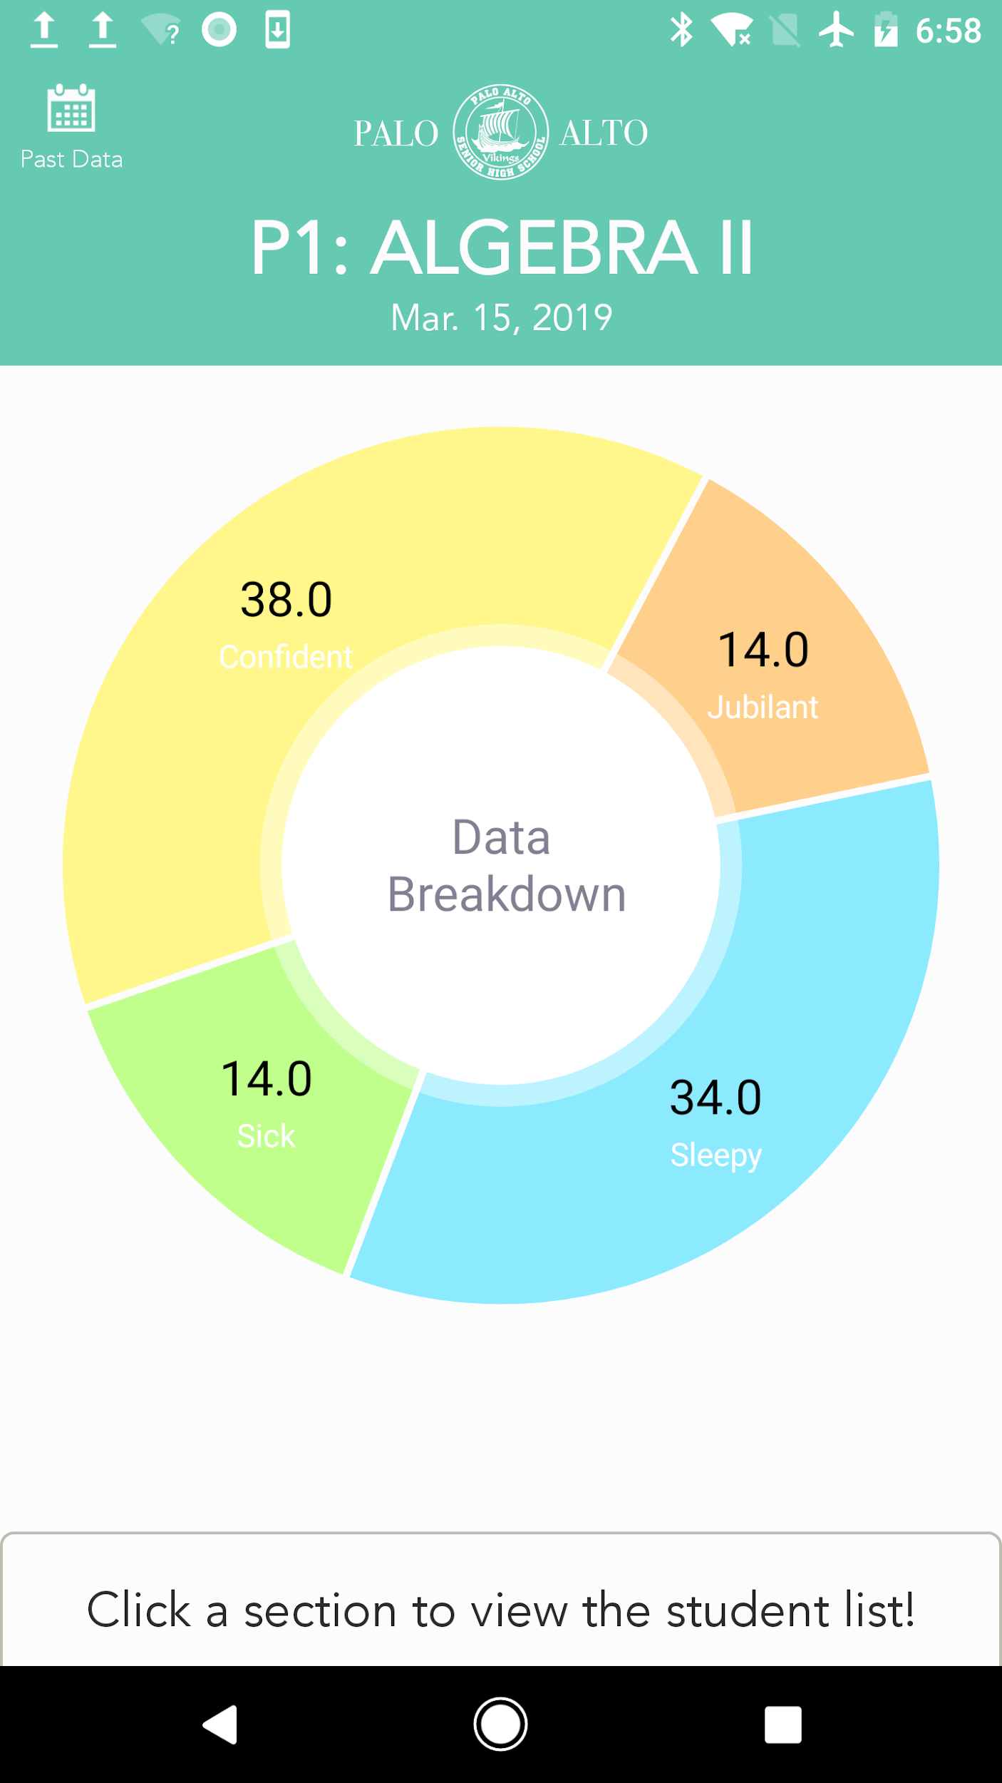
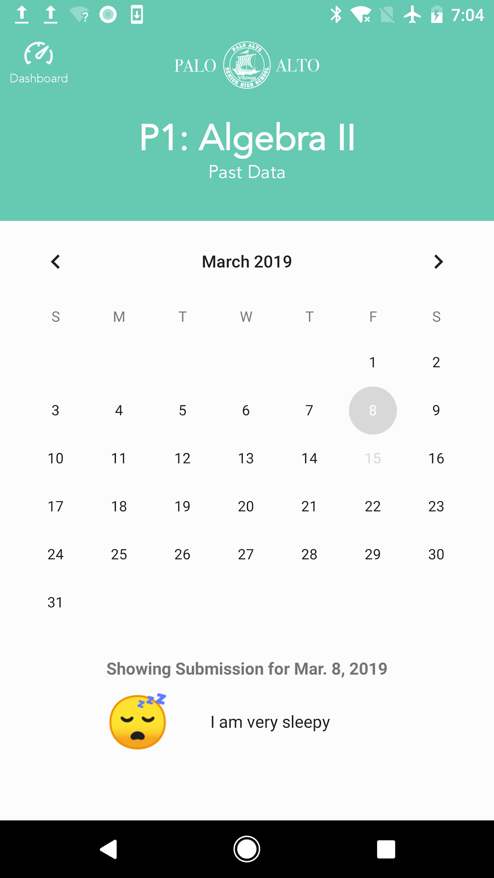
Final Hi-Fi Prototype
Notes:
Sanura
We changed many things over the course of this quarter, but we arrived at a cleaner design that is overall more friendly and intuitive.

Slide 24
User Interface
Notes:
Jailene
Now we will go over our main tasks that users will experiences when they use TellUs

Slide 25
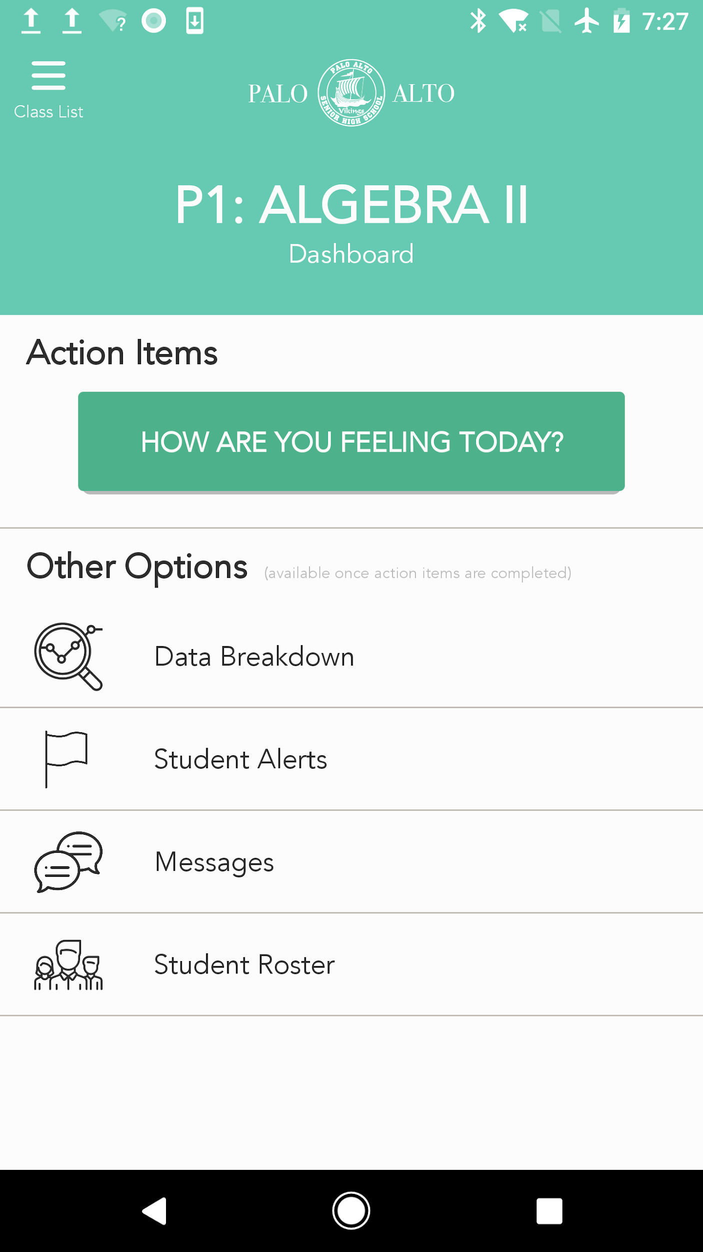
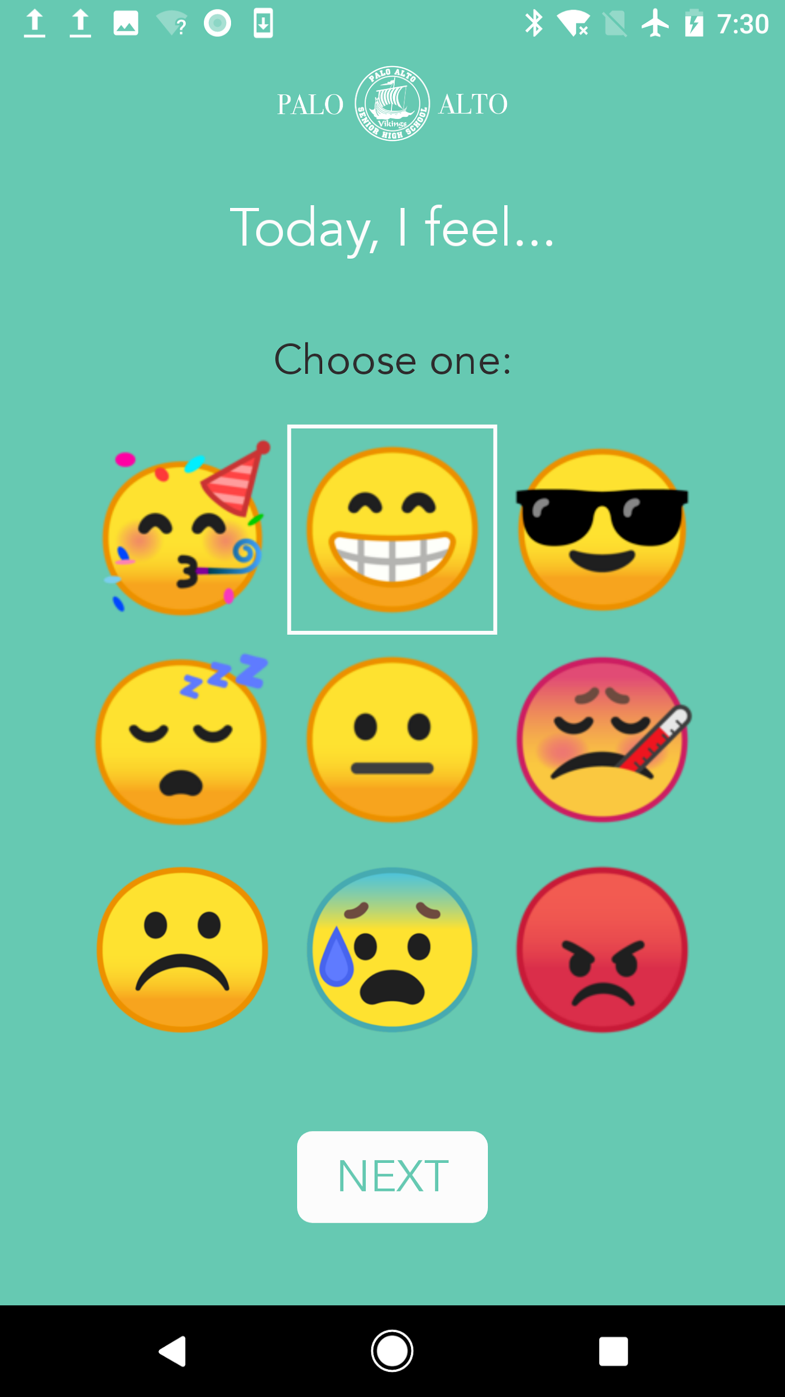
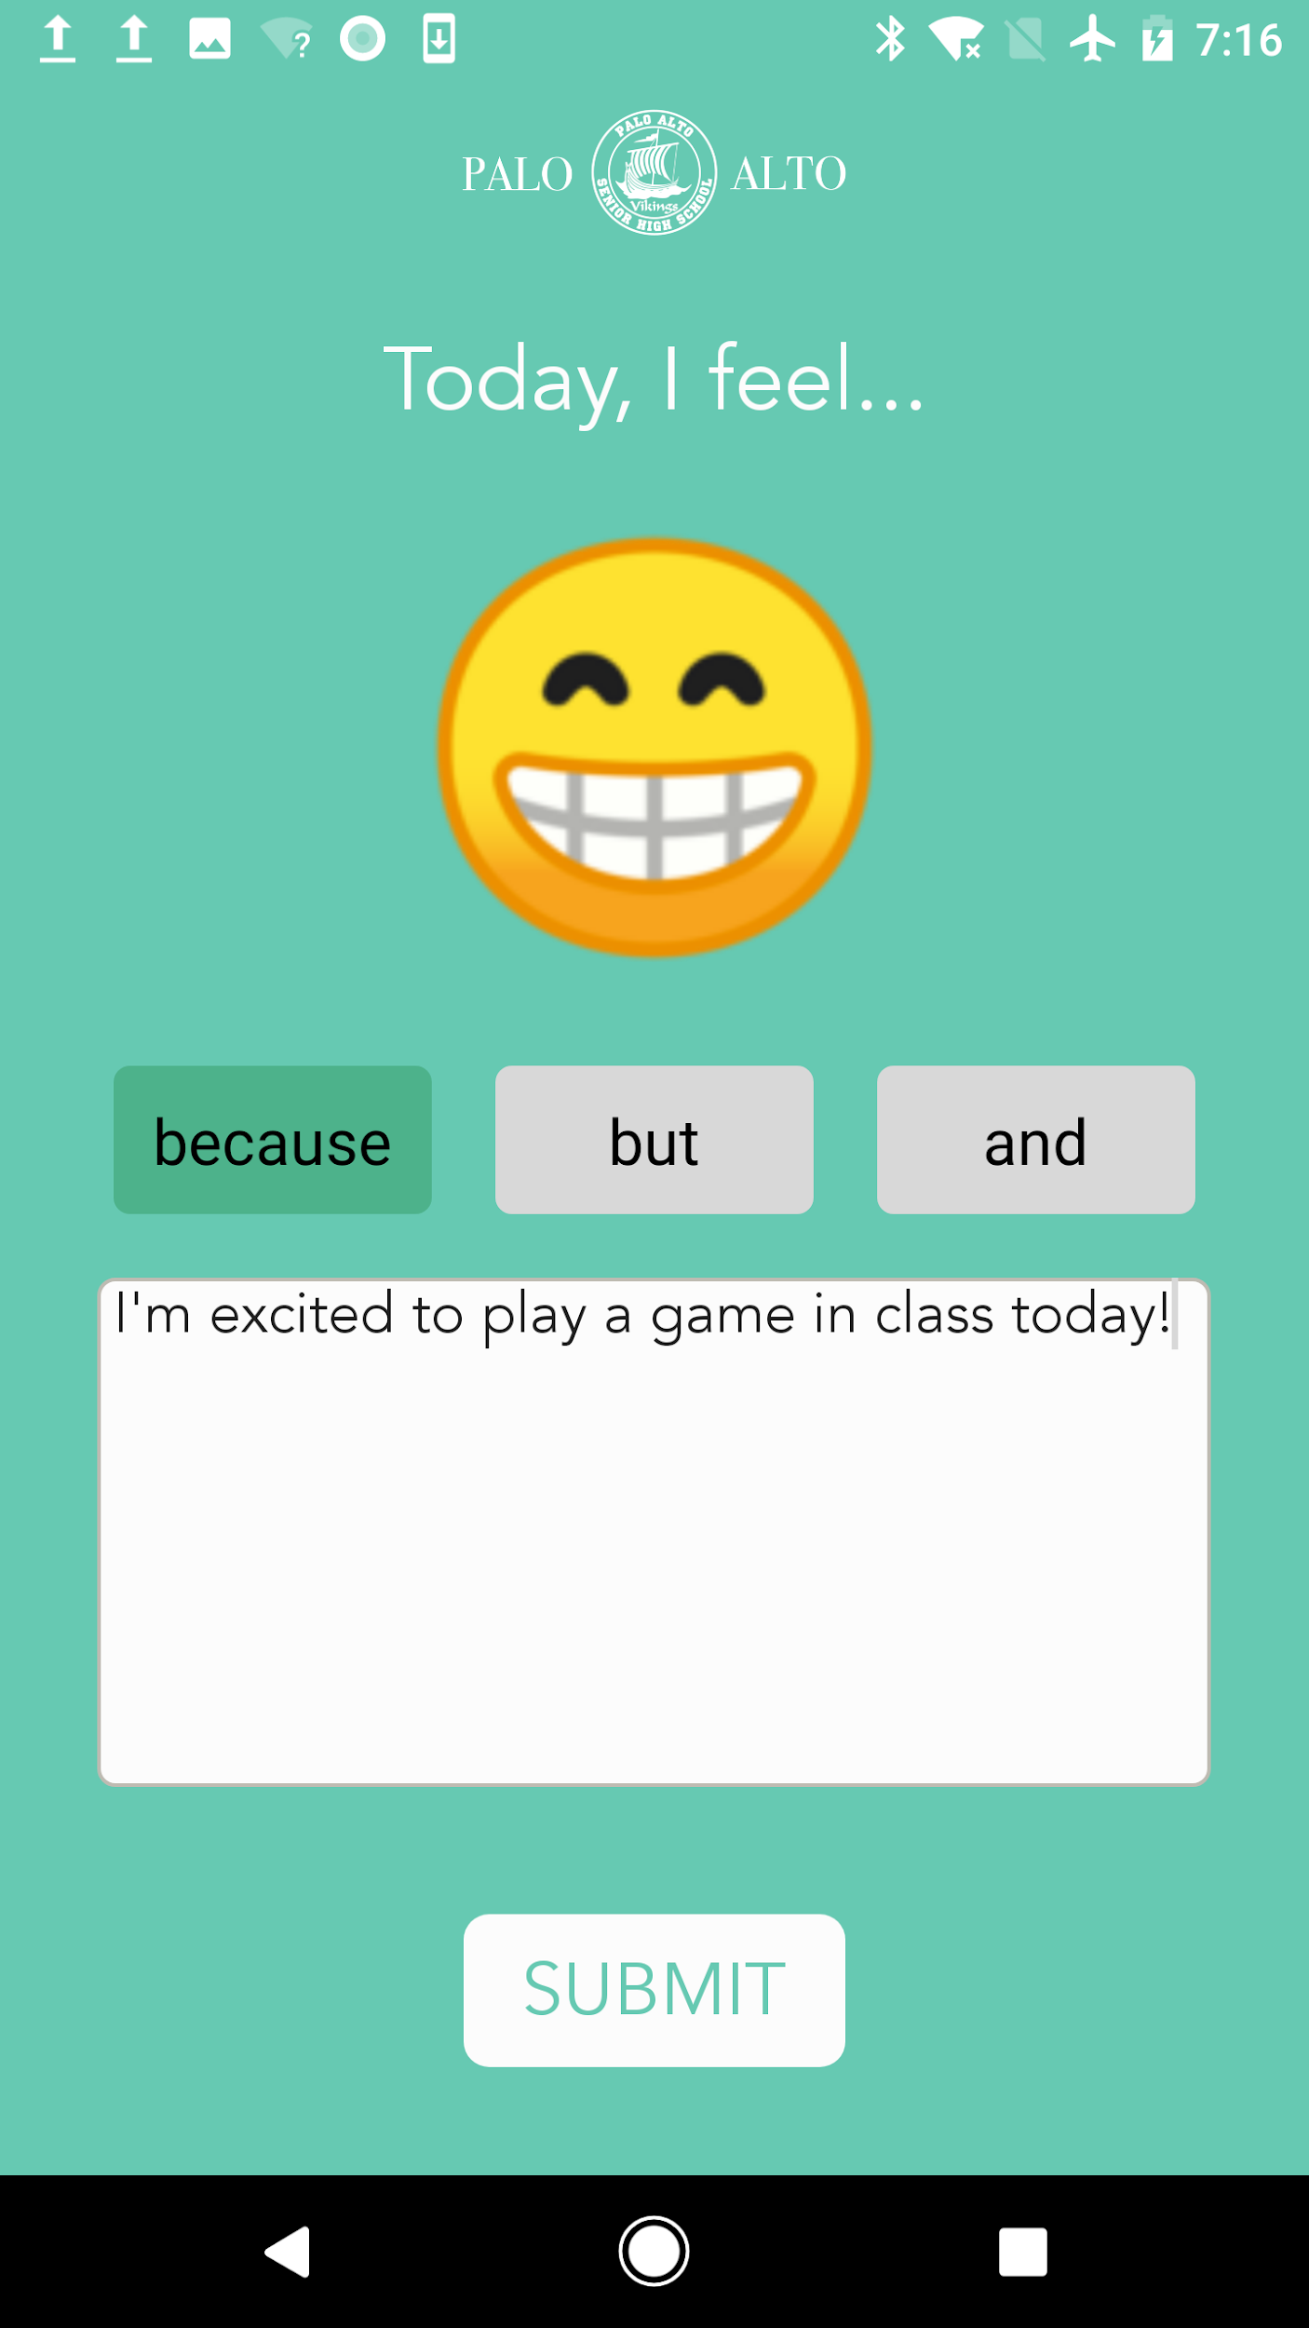
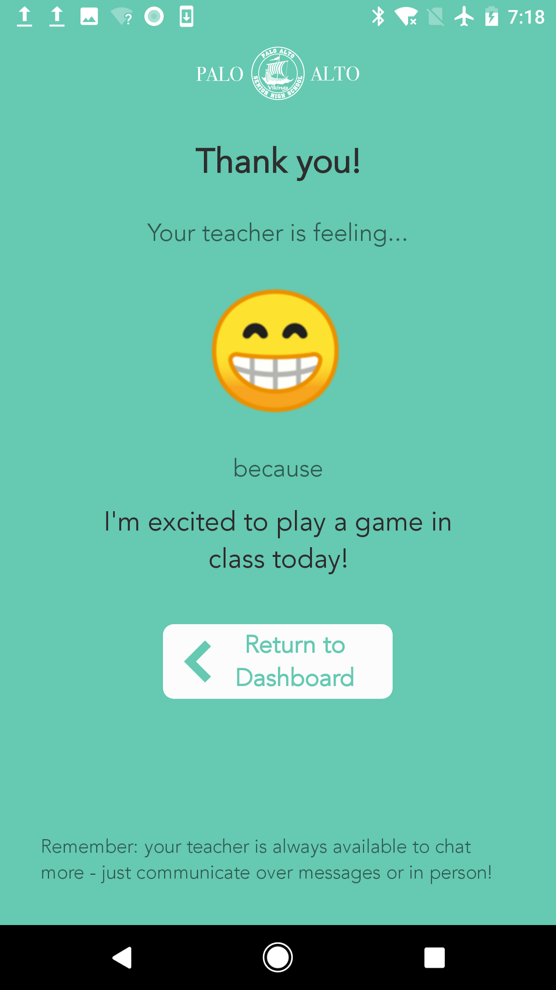
Submit how you are feeling
Notes:
Jailene
Our main task, is for both students and teacher to submit how they are feeling before the lesson begins.
for a cleaner design, we decided to separate the screens for choosing the emoji and explaining their selection.

Slide 26
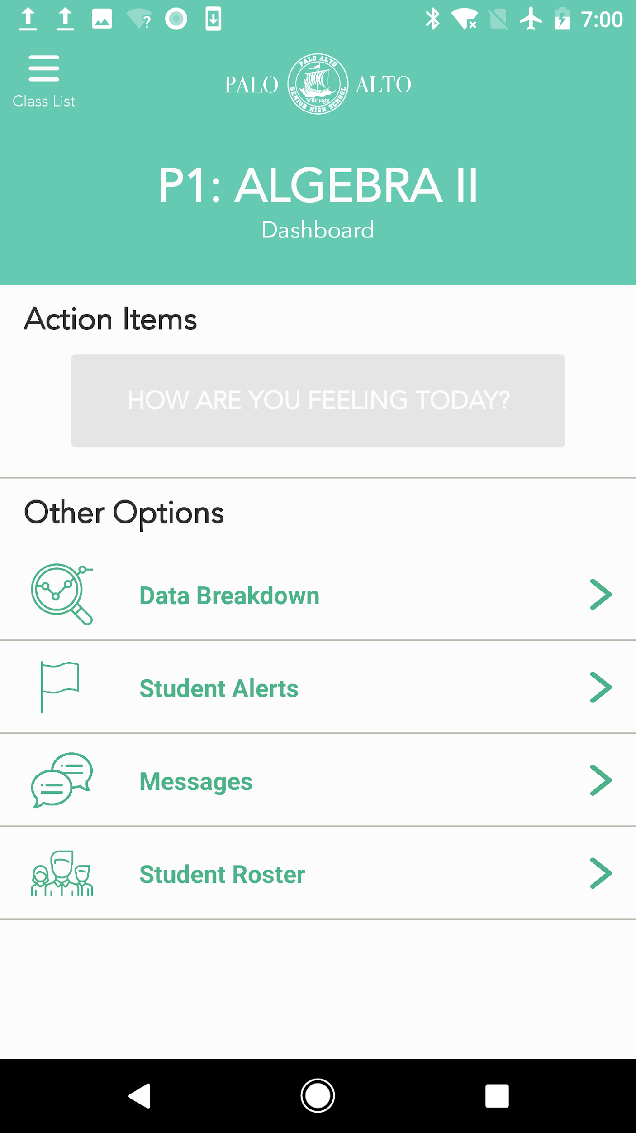
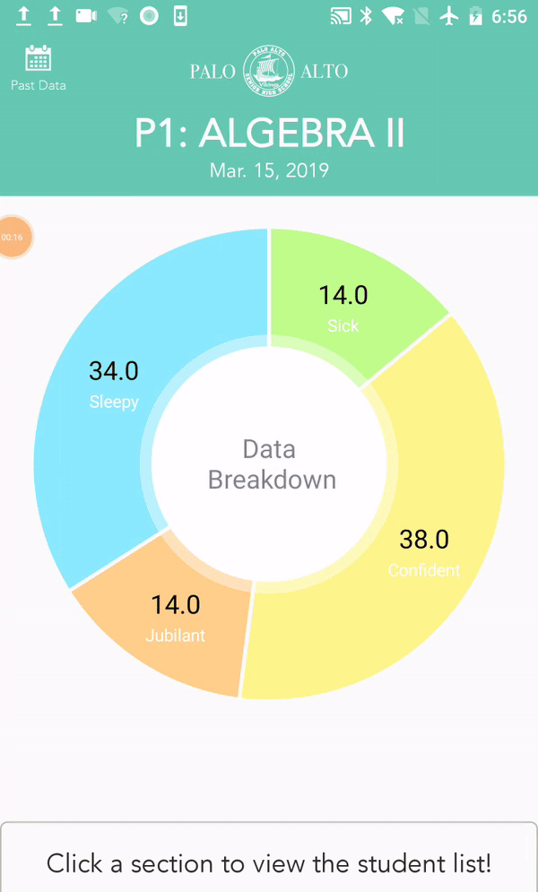
View Results
Notes:
Jailene
Our next task is for teachers to be able to quickly view the collective results of all their students’
-once the teacher submits, they can access the interactive pie chart, which will show the breakdown of student submission by clicking a certain section of the chart to view which students submitted that emoji

Slide 27
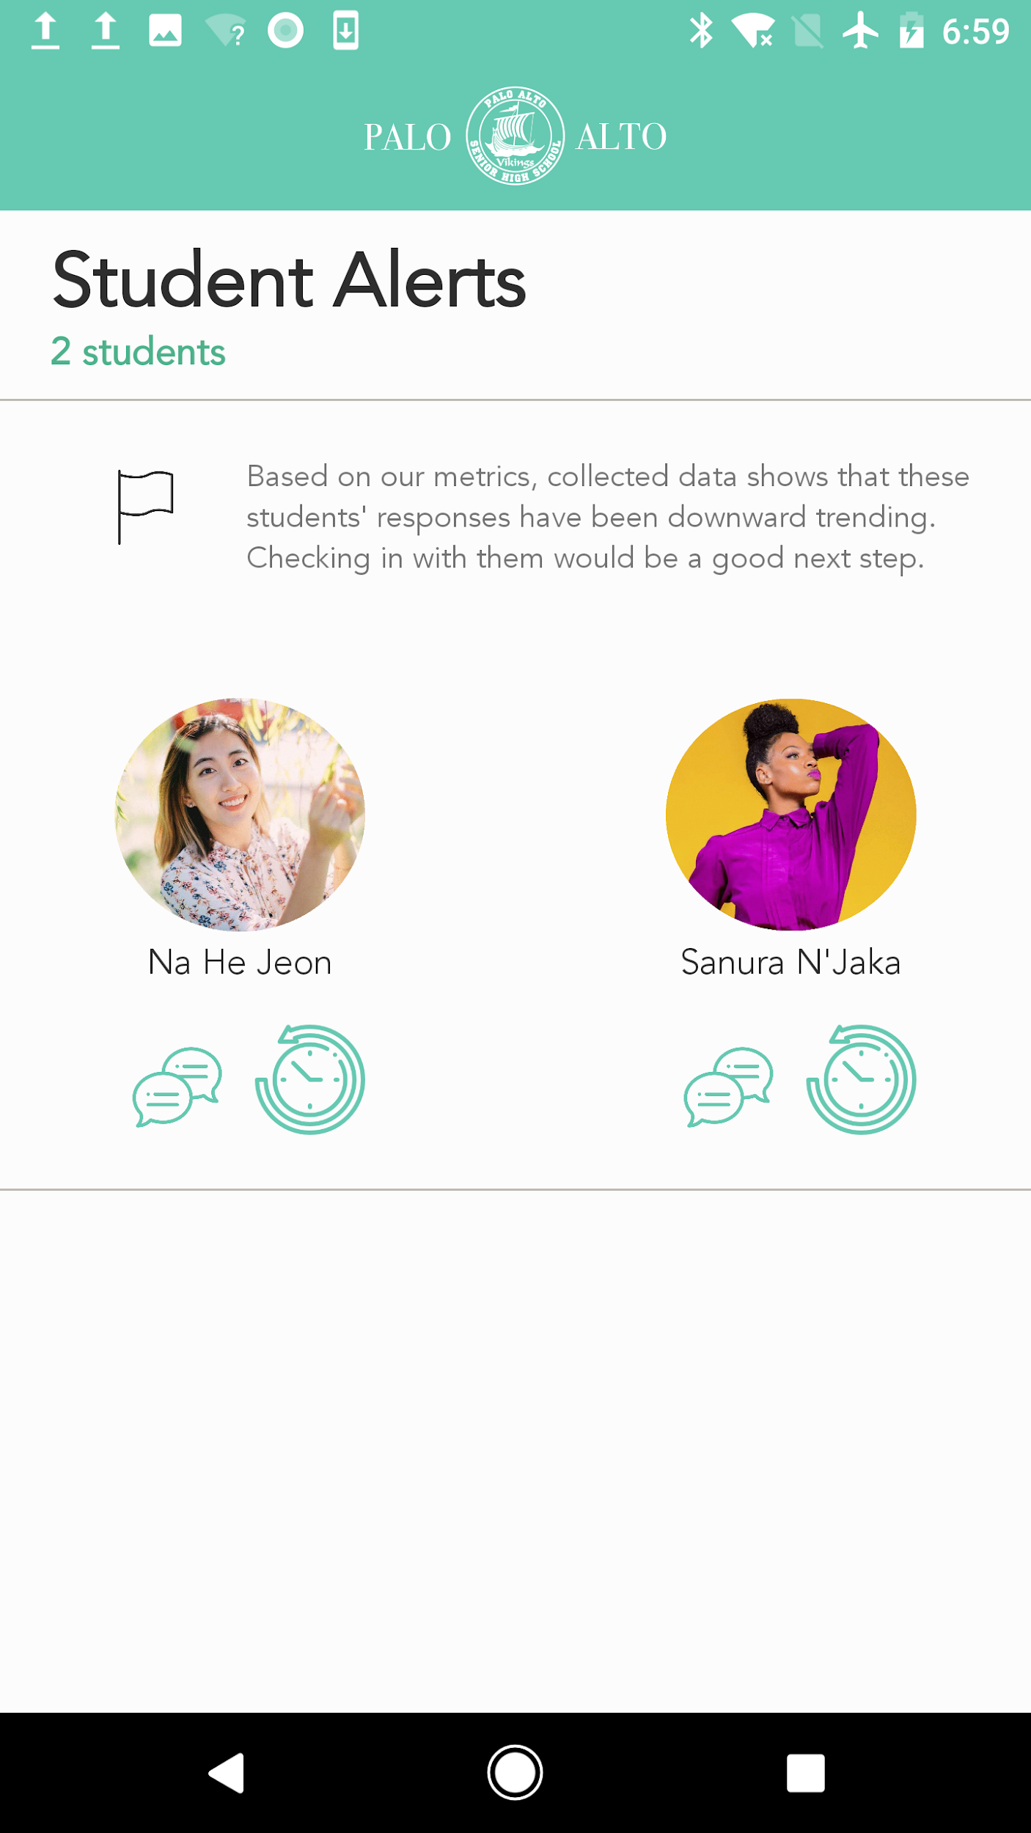
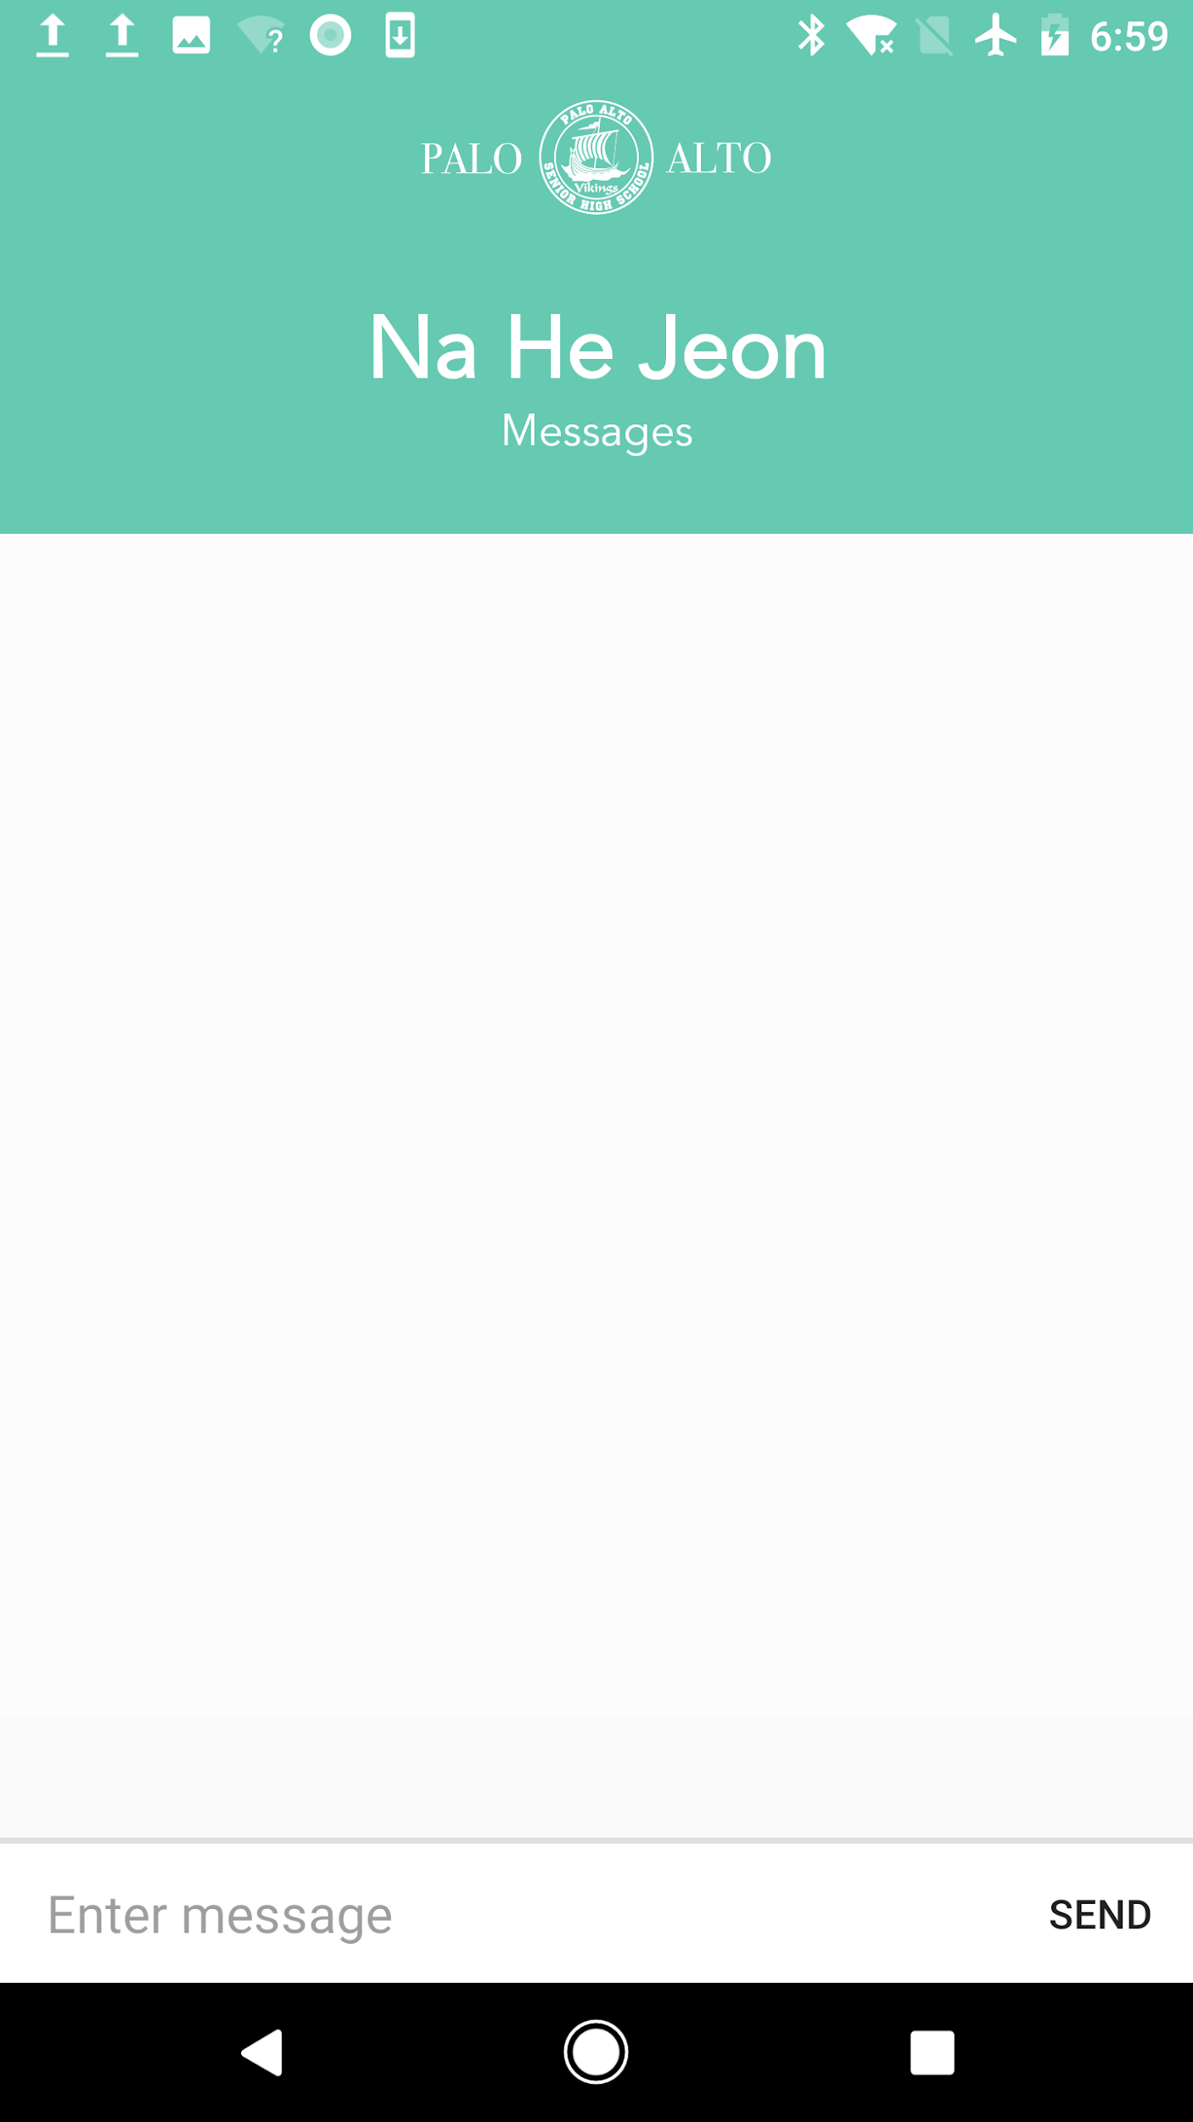
Reach out to “downward trending” students
Messages
Student History
Notes:
Jailene
For final task, teachers are able to reach out to students that are seen as “downward trending” based on a backend algorithm. “Downward trending” is described as a student having submitted “negative” emotions frequently over time.
The teacher can opt to send a message to the student directly, and/or view their submission history.

Slide 28
Implementation
Notes:
Sanura
Finally, we will discuss how we implemented our final prototype and our future plans

Slide 29
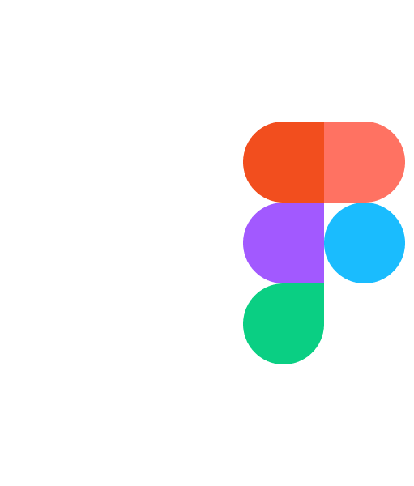


Tools
Notes:
Sanura

Slide 30
Future Plans
Create accounts using schoolwide account systems
New user tutorials
Provide lesson plan suggestions based on data analysis
Notes:
Sanura

Slide 31
Conclusion
Notes:
Sanura

Slide 32
Summary
Teacher-Student connections are vital but there’s not enough time
TellUs bridges communication between students and teachers
Notes:
Sanura

Slide 33
Connect and Engage With Your Students
http://web.stanford.edu/class/cs194h/projects/EduConnect/
Notes:
Sanura
a. Title your pitch as the opportunity rather than just the title of the project

